Slide 1
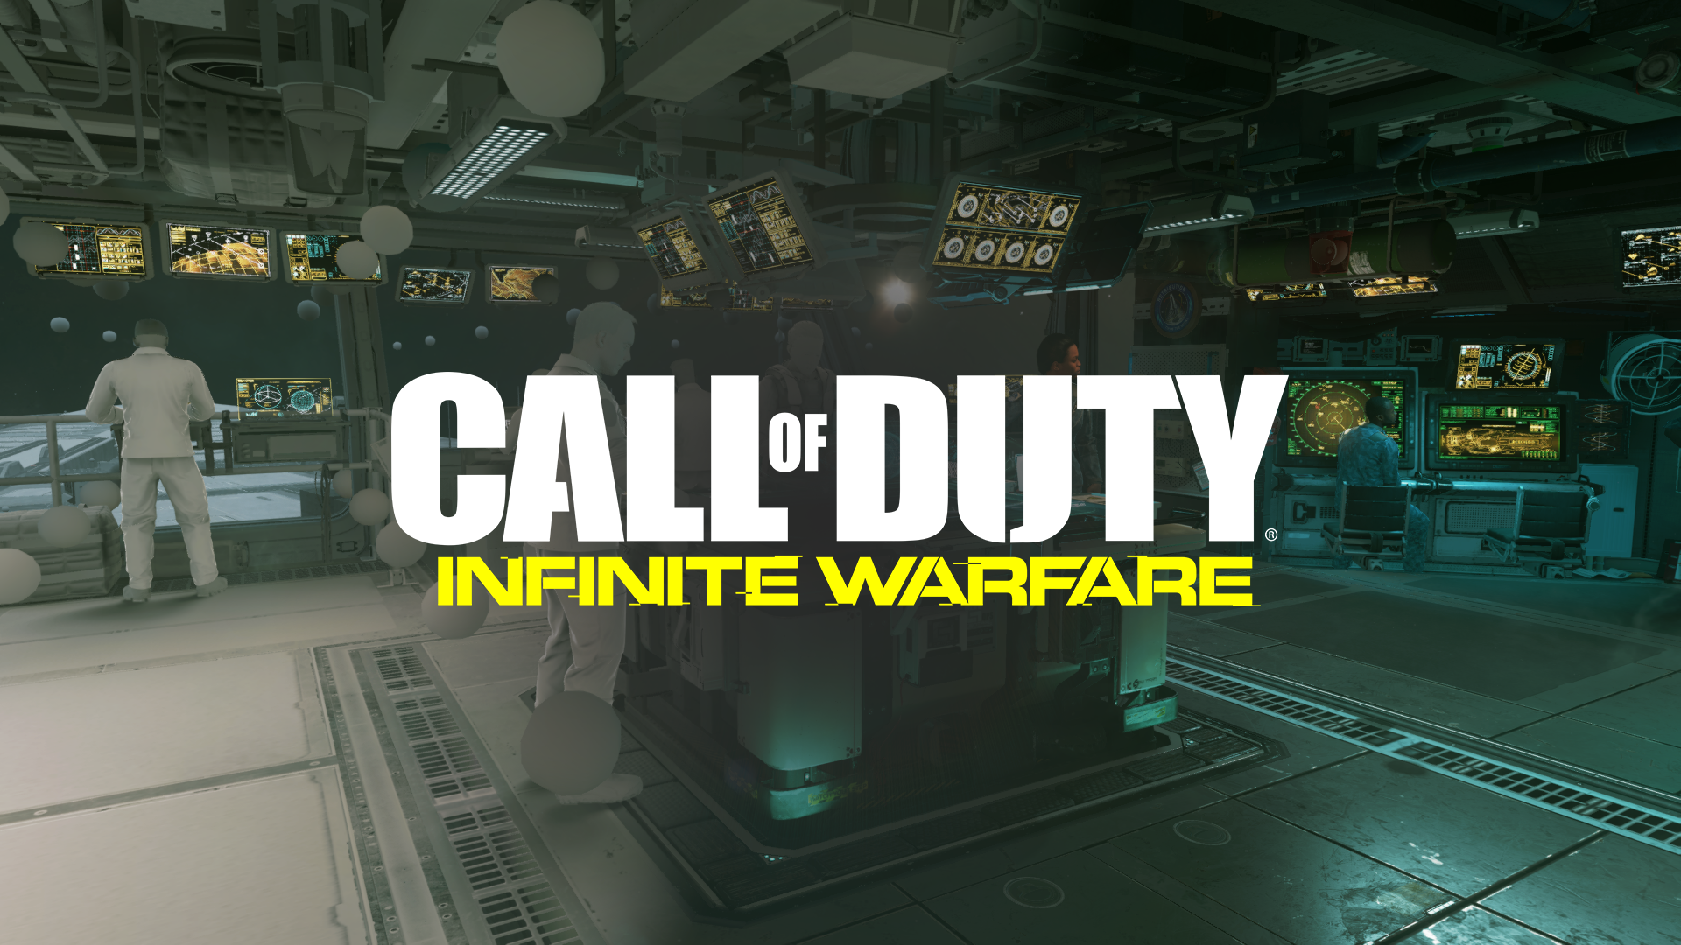

Precomputed Lighting IN
Michał Iwanicki & Peter-Pike Sloan
Activision Central Tech
Notes:
Hi everyone, I’m Michal and I’m here together with Peter-Pike and the title of our talk today is „Precomputed Lighting in Call Of Duty: Infinite Warfare”

Slide 2
Acknowledgements
Central Tech
Adrien Dubouchet
Manny Ko
Dimitar Lazarov
Josiah Manson
Mike Stark
Infinity Ward
Michał Drobot
Olin Georgescu
Ifedayo Isibor
Kyle McKisic
Peter Pon
High Moon Studios
Martin Ecker
Stephane Etienne
Sledgehammer Games
Dave Blizard
Danny Chan
Stephanus
Luka Romel
Atsushi Seo
Notes:
Before i start i wanted to say that *a lot* of people contributed to the ideas we will present here and we wanted to thank them all for that

Slide 3
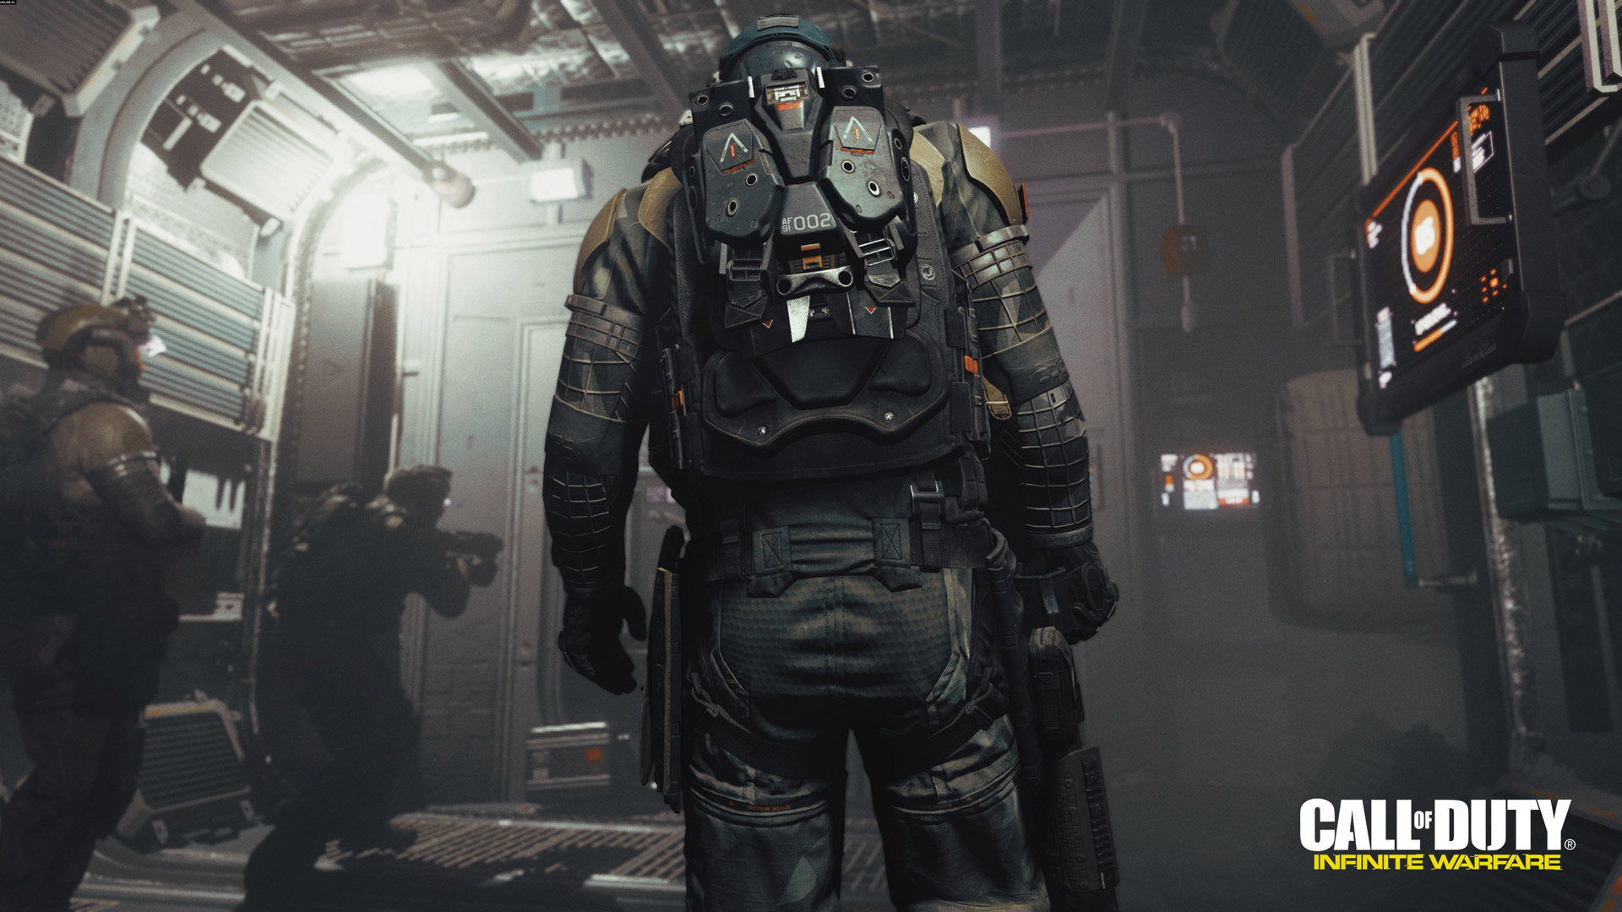
Notes:
In the unlikely case you haven't heard about Call Of Duty, it’s a first person shooter with fast paced action, running 60 fps

Slide 4
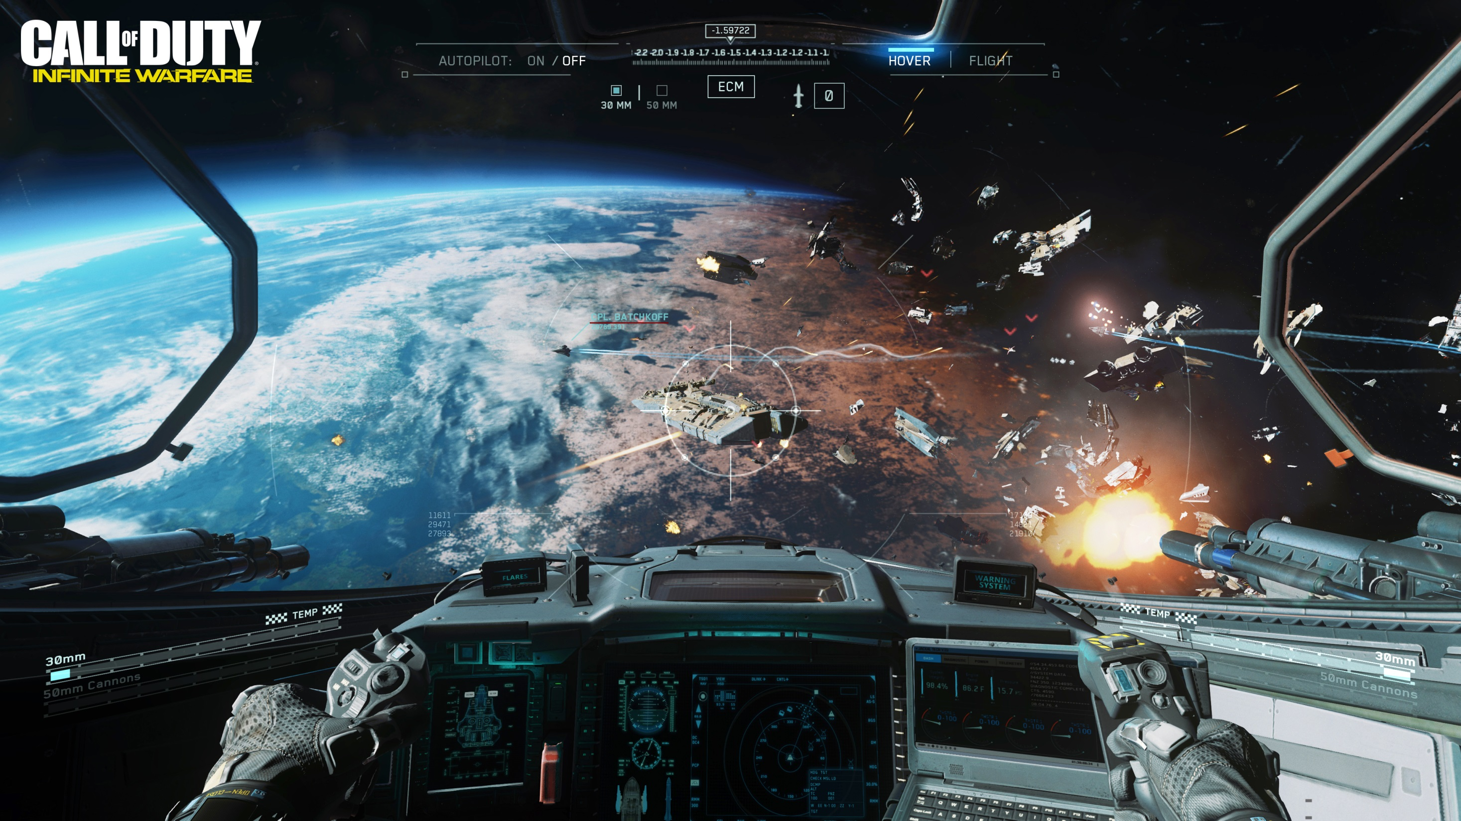
Notes:
The latest installment – Infinite Warfare – takes the player into space – we fight on Earth, but also on Moon, Mars, and in space!

Slide 5
HIGH LEVEL OVERVIEW
Indirect lighting in CoD:IW is a combination of:
Lightmaps
Probe lighting
Lightmaps – big structural geometry
Representation
Projection
Light probes – everything else
Decoupling visibility from lighting
Representation of visibility
Interpolating the lighting
Light grid structure for storage and access
Generation
Baking
Visibility representation
Notes:
And for all that we need some sort of rendering indirect lighting. It needs to look good and it needs to be fast – because, like i said, we’re running 60hz. So just to give you a quick overview of what we’re going to talk about – the indirect lighting in CoD:IW is a combination of lightmaps and probe lighting. Lightmaps are used fairly sparingly, on big, structural geometry only, and we’ll cover how we store them, how we bake and project to that representation.
Everything else is lit with probe lighting – and we’ll cover how we decouple lighting from visibility signal, how we store and interpolate them and also talk about the light grid data structure that we use to query the indirect lighting at runtime.

Slide 6
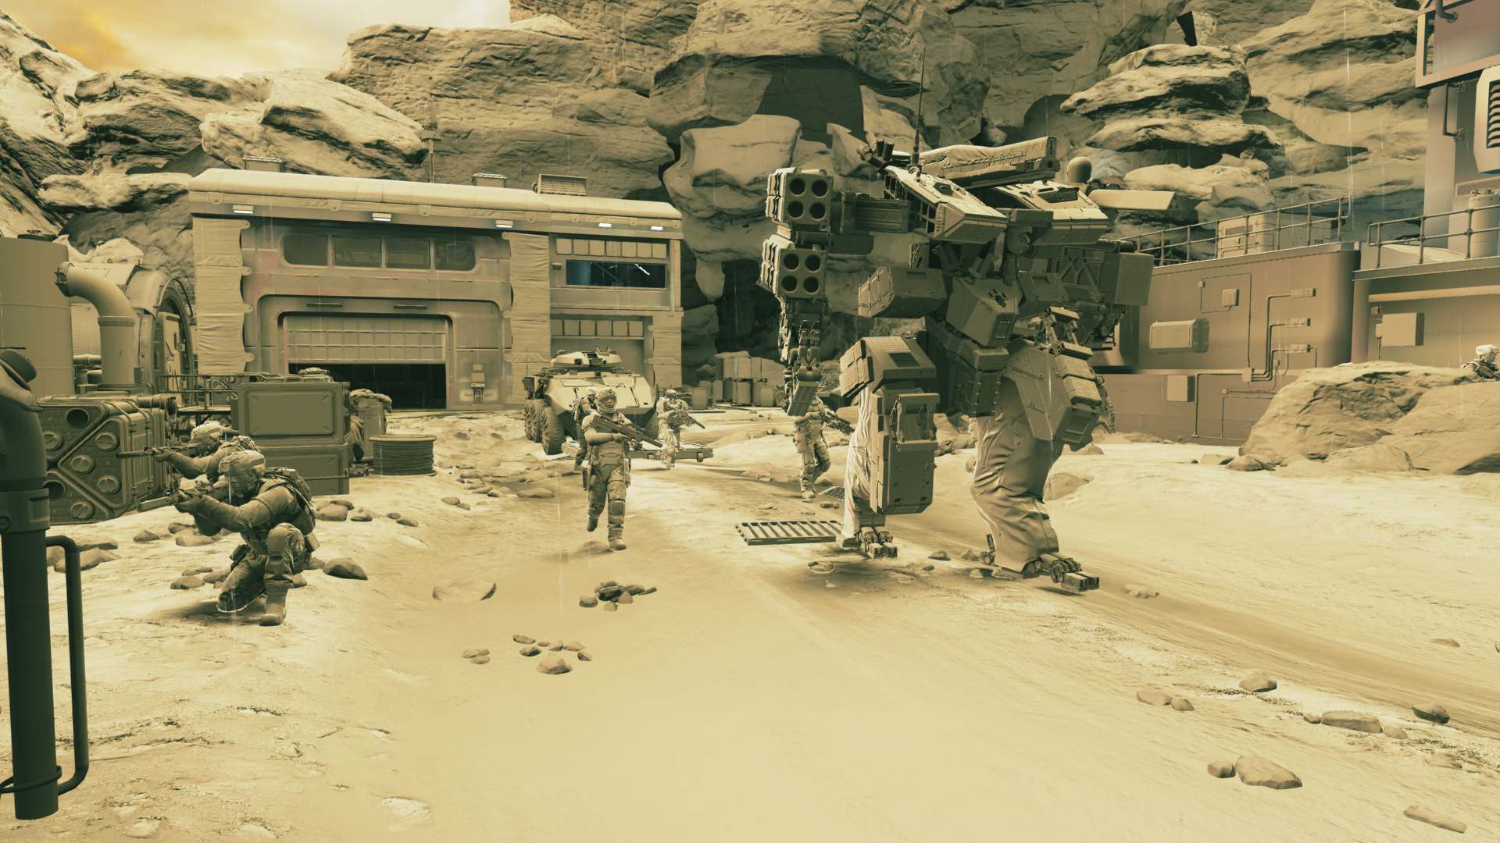
INDIRECT LIGHTING
Notes:
This is an example scene rendered with just the indirect lighting

Slide 7
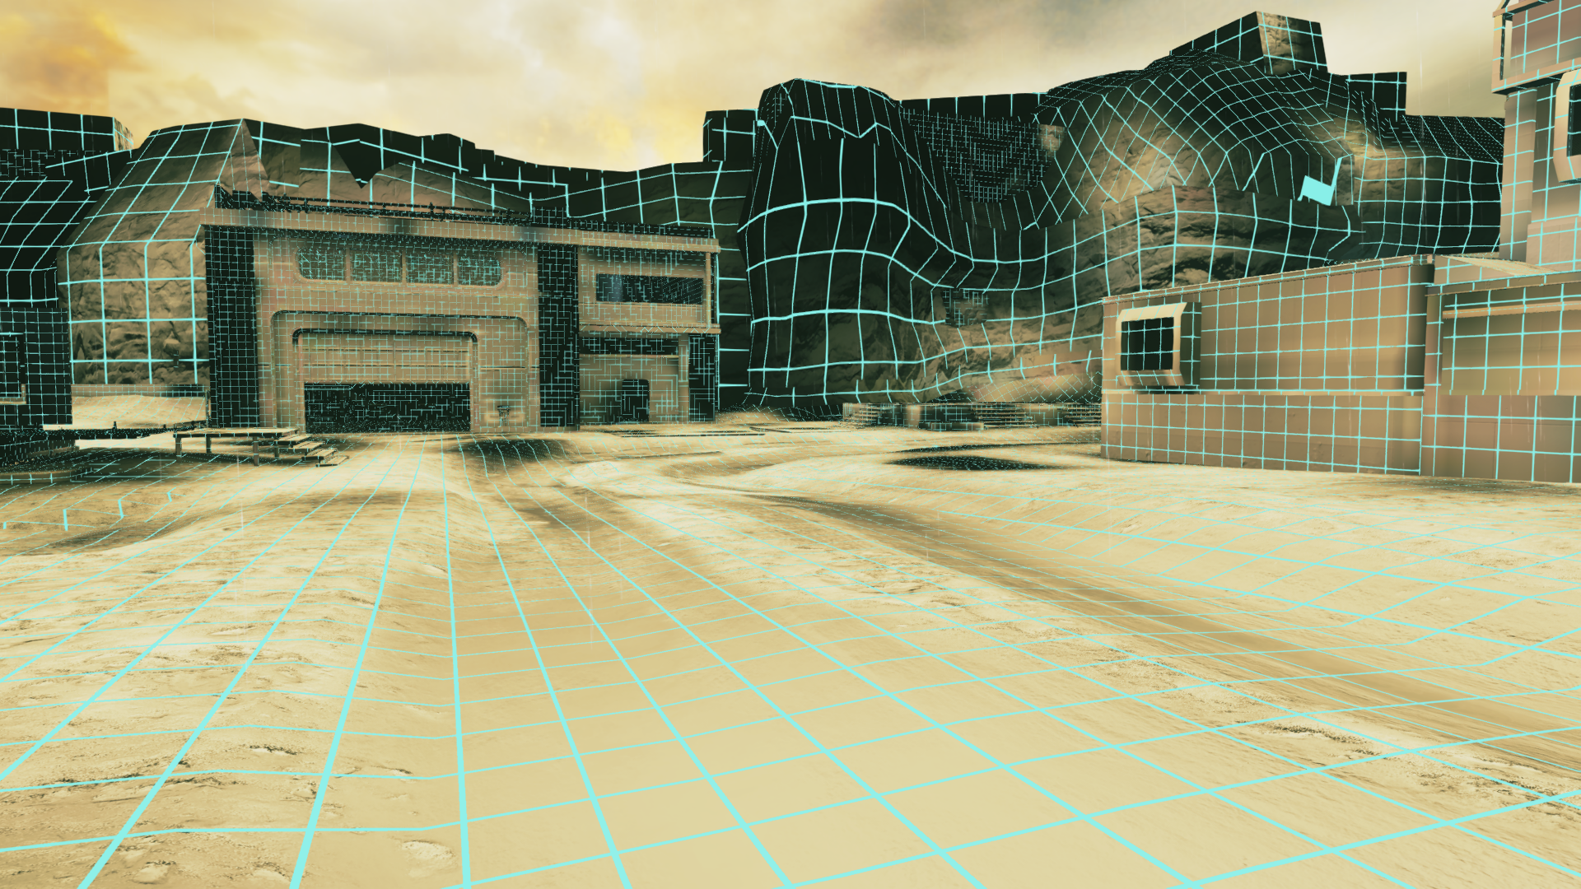
Lightmapped geometry
Notes:
This is just the lightmapped objects – so as you can see only the big, base geometry

Slide 8
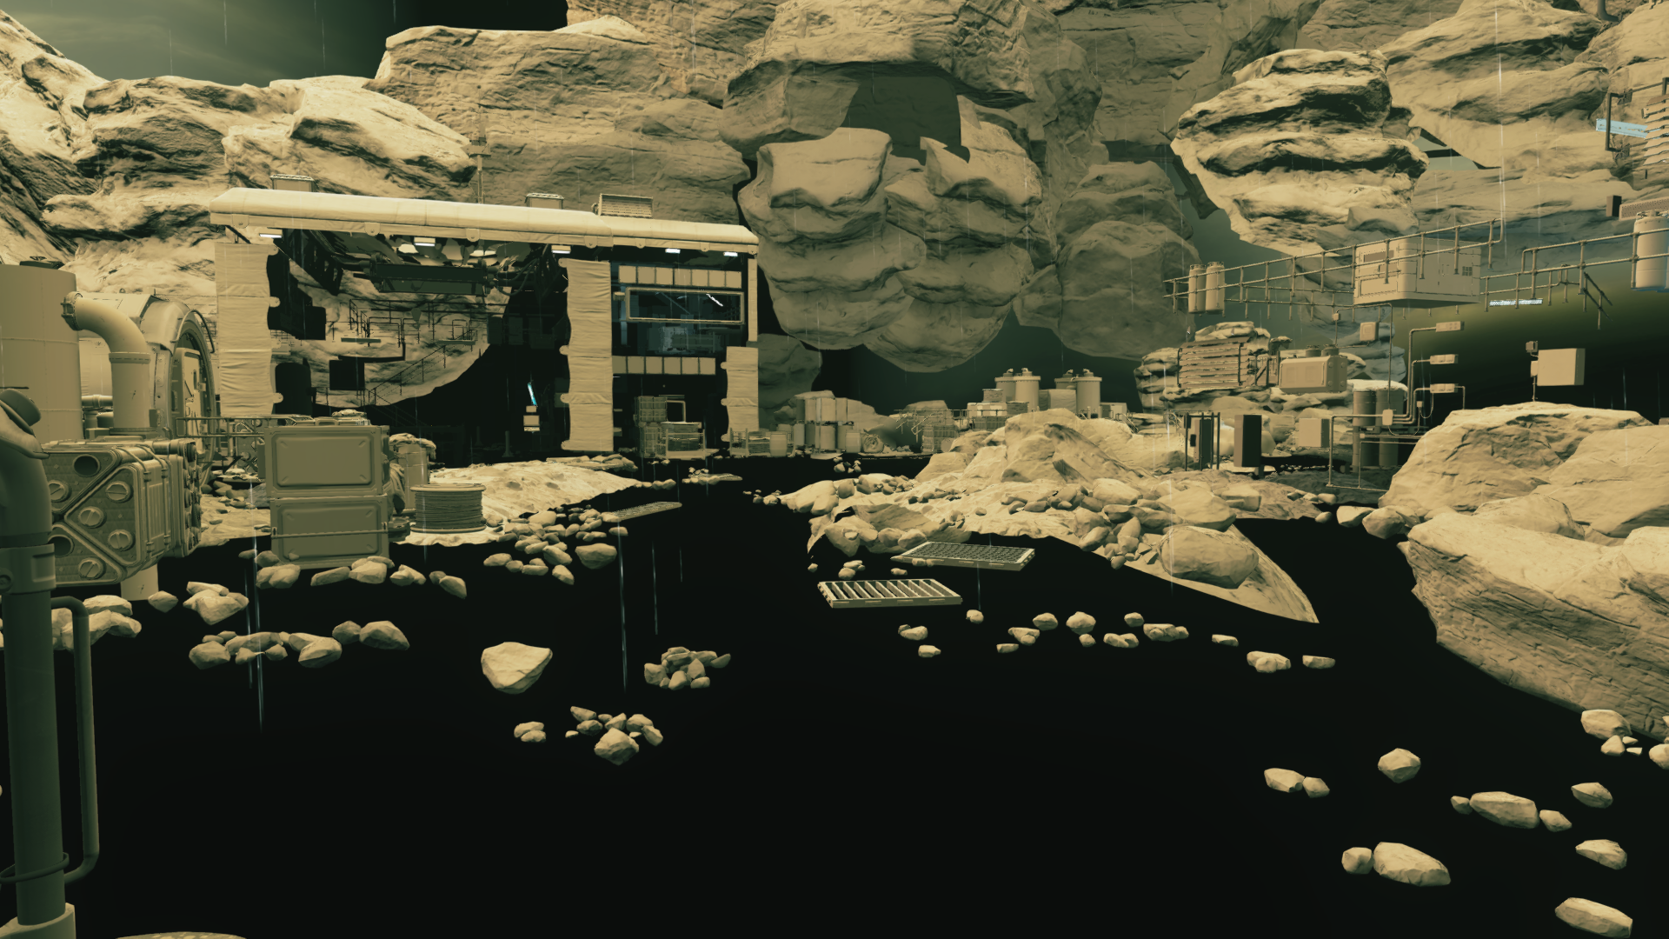
STATIC probe lit geometry
Notes:
All those are static object that are lit with light probes

Slide 9
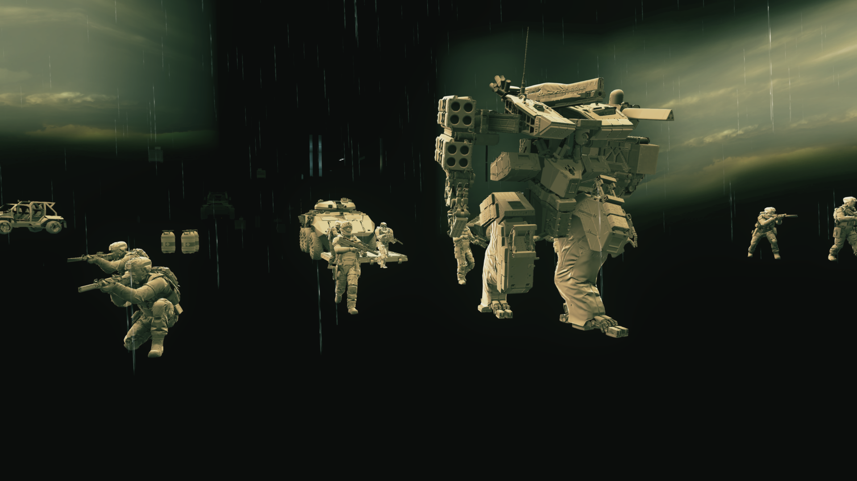
Dynamic probe Lit Geometry
Notes:
And those are the dynamic ones, also lit with probes

Slide 10
STRUCTURAL GEOMETRY
Lightmaps
(A)mbient + (H)ighlight (D)irection encoding
We explored other options but AHD gave biggest bang/$
In tangent space
Hemi-octahedral encoding
BC6H for the colors
option to disable compression on per-map basis
Notes:
First the lightmaps – just briefly here, they’ve been around for a while, we like them. They are really simple and fast to look up – which is priceless for us. Also, their dimensionality matches the dimensionality of the surface. This way there’s a linear relationship between the area of the lightmapped geometry and the memory consumption.
To encode the directional signal and allow for local normal variation, we use what we call AHD encoding – which stands for Ambient and Highlight Direction – so a combination of ambient and directional light for every pixel of the lightmap. We looked at other representations, Peter-Pike will talk about this more in a bit, but AHD simply gave us the biggest bang for a buck. We store the direction in tangent space, which lets us to use hemi-octahedral encoding for it. For the two colors we compress them using BC6h, and while we had some minor quality issues with that, artists had an option to disable the compression on per-map basis.

Slide 11
EveryTHING ELSE
But lightmaps are not a silver bullet
Bushes, small geometry etc.
Previously mostly vertex lit or probe lit
Vertex lighting costly
every instance has an extra vertex stream with *directional* lighting data
Typical probe doesn’t really look well
We wanted some elegant solution for that
Notes:
But we are aware that lightmaps are not a silver bullet – they work great in some cases, and totally don’t in others. Things like small geometry, bushes, things with more volumetric structure, lightmap poorly. In previous games we use either vertex lighting or probe lighting for them. The problem was that vertex lighting looked great but was pretty costly, as every instance had to had a second vertex stream with the directional lighting information. The probe lighting on the other had was pretty cheap, because we only had to store one lightprobe for such objects, but it didn’t really look good, and we wanted to get a solution that would look good and be cheap.

Slide 12
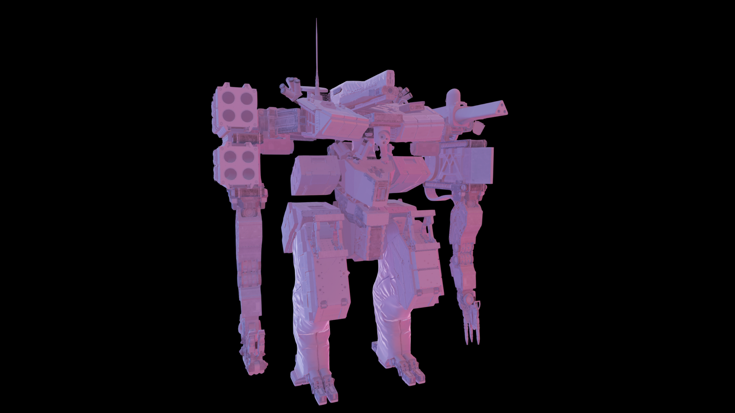
Typical PROBE LIGHTING
Notes:
Now, this is what the typical probe lighting usually looks like. And by „typical” i mean that you sample lighting in one location and use it for the whole object, it’s usually encoded as 3rd order spherical harmonics, it’s looked up by the normal, you do the convolution with the cosine on the fly and voila. And this of course gives you some directional variation, but in general looks fairly flat and uninteresting

Slide 13
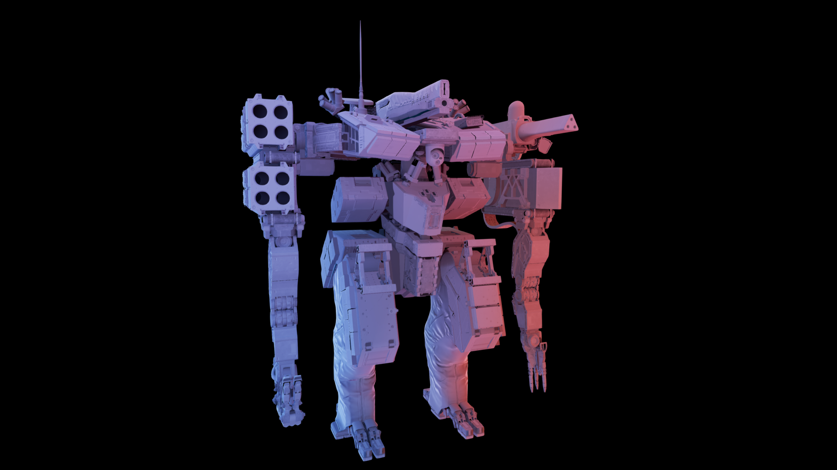
WHAT WE WANT
Notes:
What we really want is something like that – so with spatial variation over the object, with proper account for occlusion – something that would be comparable in quality with baking lighting per vertex.

Slide 14

DECOUPLE
Rendering equation for diffuse surface under distant lighting with occlusion only:
Two terms with very different characteristics:
Incoming radiance – smooth and well behaved
Visibility – changes quickly, high frequency directional components
Decouple the two!
Notes:
So how did we approach the problem? If you look at the rendering equation, in a version with a distant lighting and visibility only, so we’ll be ignoring bounces of the lighting off the object itself, there are two main term there – lighting and visibility. And they have very different characteristics – lighting is fairly well behaved, changes spatially in a smooth way, if we’re considering diffuse response only, like here, we can treat is as varying smoothly directionally too. And visibility is nothing like that, it changes very rapidly across the object, has a lot of discontinuities. So the idea was to decouple the two and think of them separately.

Slide 15
DECOUPLE
Can reason about lighting and self visibility separately
encode in different ways
interpolate separately
Saves tons of memory
visibility can be shared
lighting changes at low spatial rate – can be stored at lower resolution
In our particular case:
Visibility stored at vertices
Lighting stored at some number of points on the object – more later
Notes:
Because when we do this we can encode the two in a different way, we can interpolate them in a different way. And we can save a lot of memory, because the visibility is no longer unique for every instance – it can be shared between the copies of the object – and the lighting, even though it is unique, it changes at a low spatial rate so it can be stored in much lower resolution.
In our particular case we store visibility at the vertices and the lighting in some number of points scattered around the object – and we’re gonna talk about those two components now.

Slide 16
VISIBILITY
Store visibility as a cone:
Axis
d
d
d
Notes:
First the visibility – we store it as a scaled cone – so for every vertex on a mesh we store its axis – the main unoccluded direction

Slide 17
VISIBILITY
Store visibility as a cone:
Axis
Cone angle
d
d
d
θ
θ
θ
Notes:
Then, we store the cone angle – so the wider the unoccluded portion of the hemisphere is, the wider the cone

Slide 18
VISIBILITY
Store visibility as a cone:
Axis
Cone angle
Scale (0 to 1)
Visibility is shared between instances
Need to bake only once – during conversion
d
d
d
θ
S
θ
θ
S
S
Notes:
And then we store the scale – from 0 to 1, to have an extra degree of freedom, to be able to represent more stochastic visibility, which a single cone might not be a good representation of. So when a point is occluded from multiple directions, instead of compensating this with the smaller angle, we can use a wide angle and just scale it down.
And like i mentioned, visibility is shared between instances and baked only once, during mesh import.

Slide 19
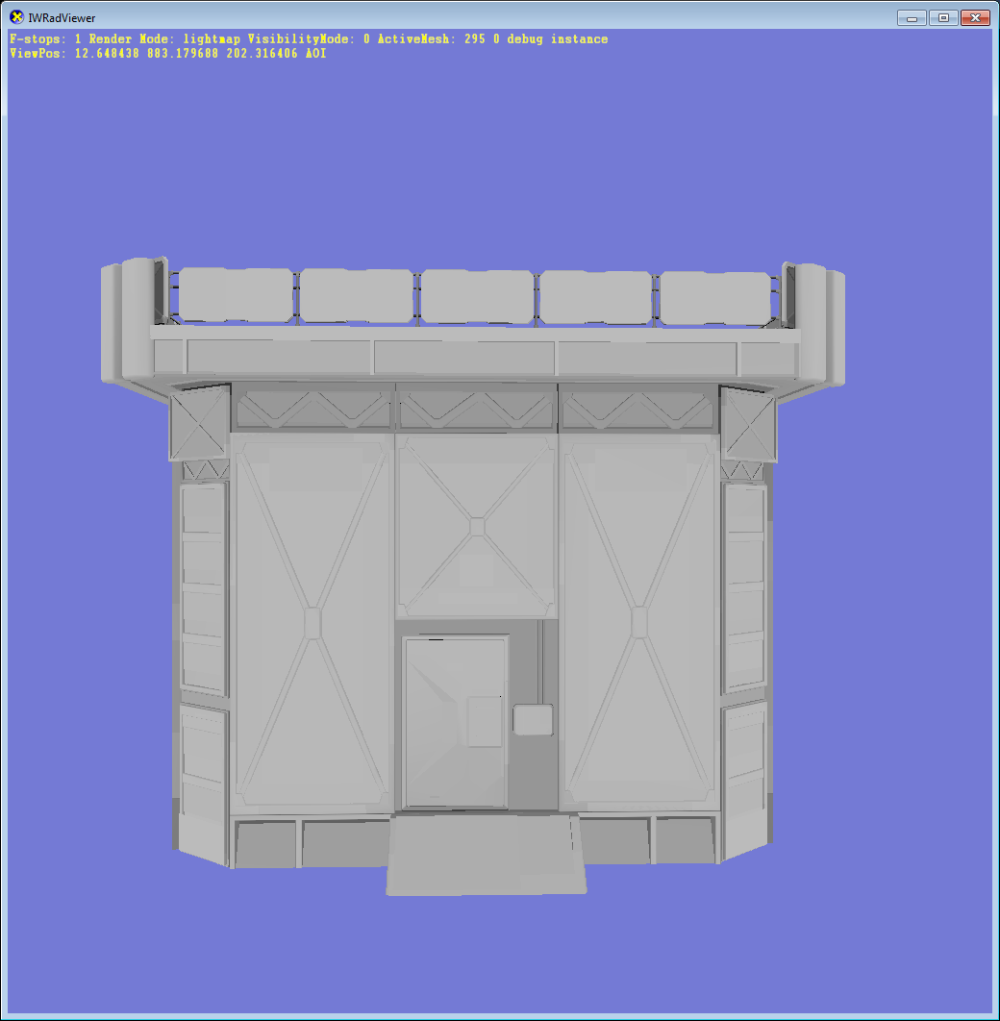
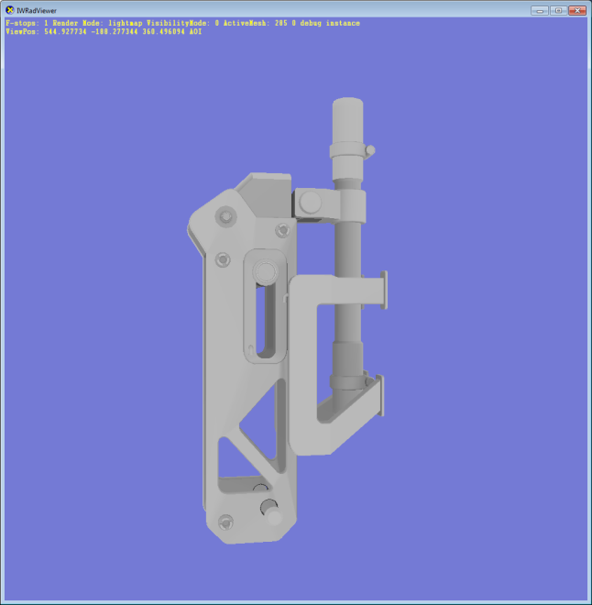
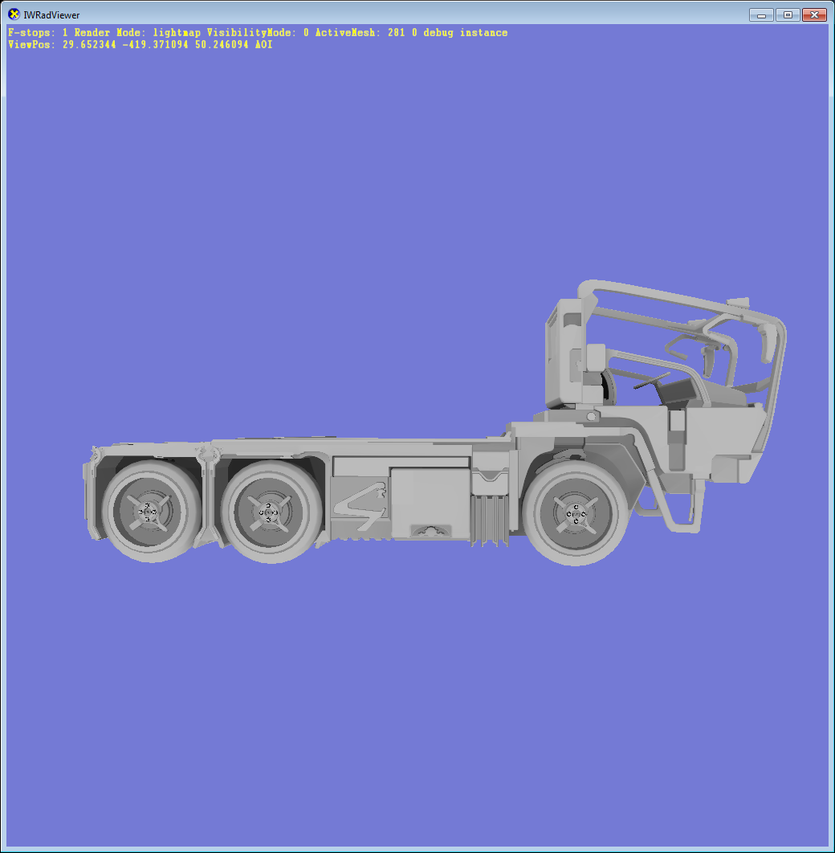
BAKING Visibility
Generate 4th order SH
Uniform sampling over the surface
Validate sample
Non-linear iterative smoother
Interpolate norm of linear SH as extra channel, rescale
Notes:
To get the visibility, we bake 4th order sh vector. We uniformly sample the mesh area, we validate each such sample – to check if it’s not buried etc – and then we derive the values at the vertices from the baked samples. We do a couple iterations of smoothing and averaging of the baked data, to make the visibility signal cleaner

Slide 20
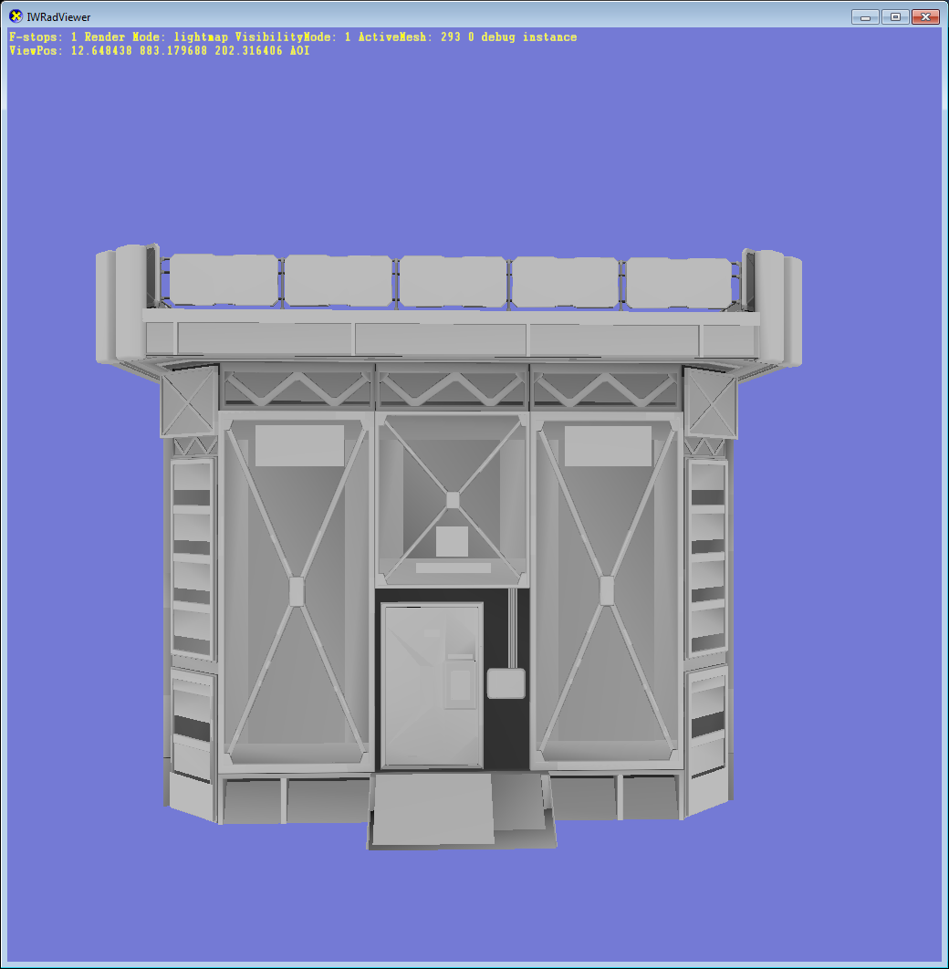
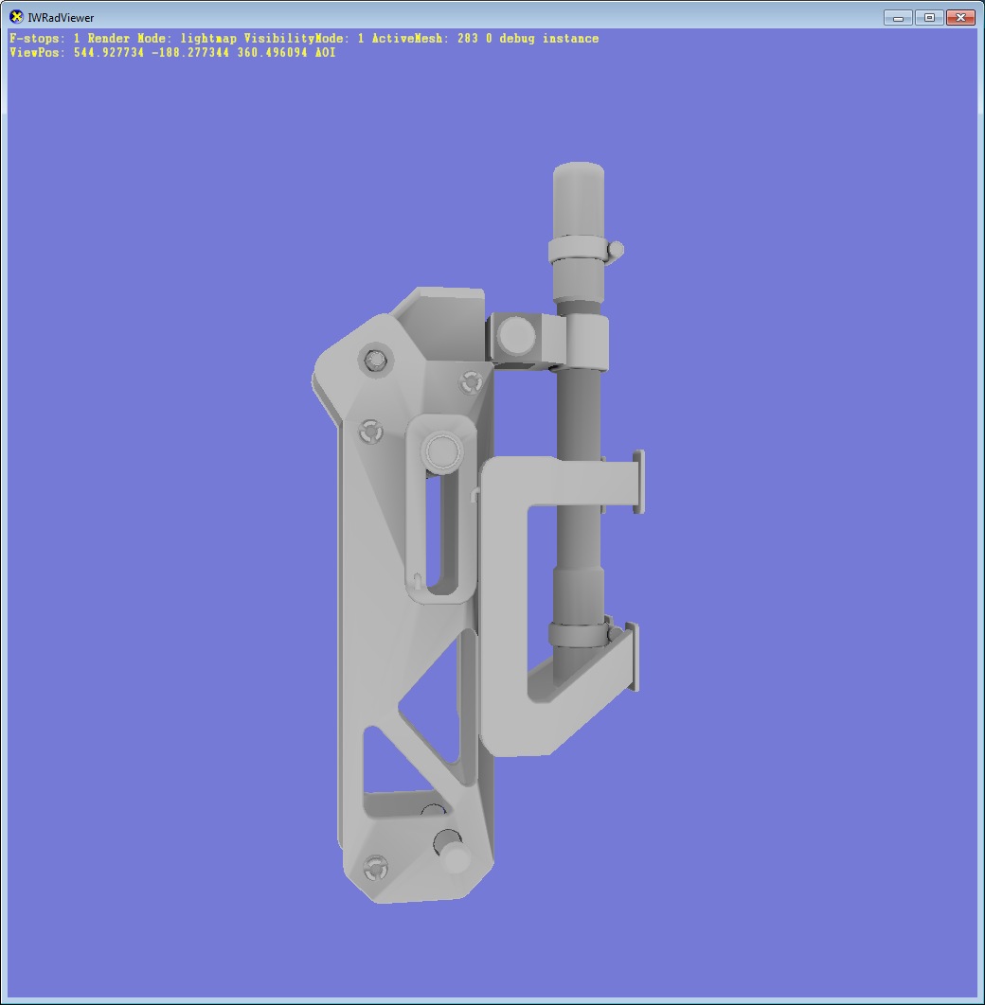
Self visIBILITY no inpaint no blur
Notes:
This is a comparison what that inpainting and blurring process gives – those are meshes baked with no post processing – as you can see they are slightly too dark in certain areas and there are some artifacts visible.

Slide 21

Self visIBILITY inpaint and blur
Notes:
And after all that post processing all those problems are gone

Slide 22
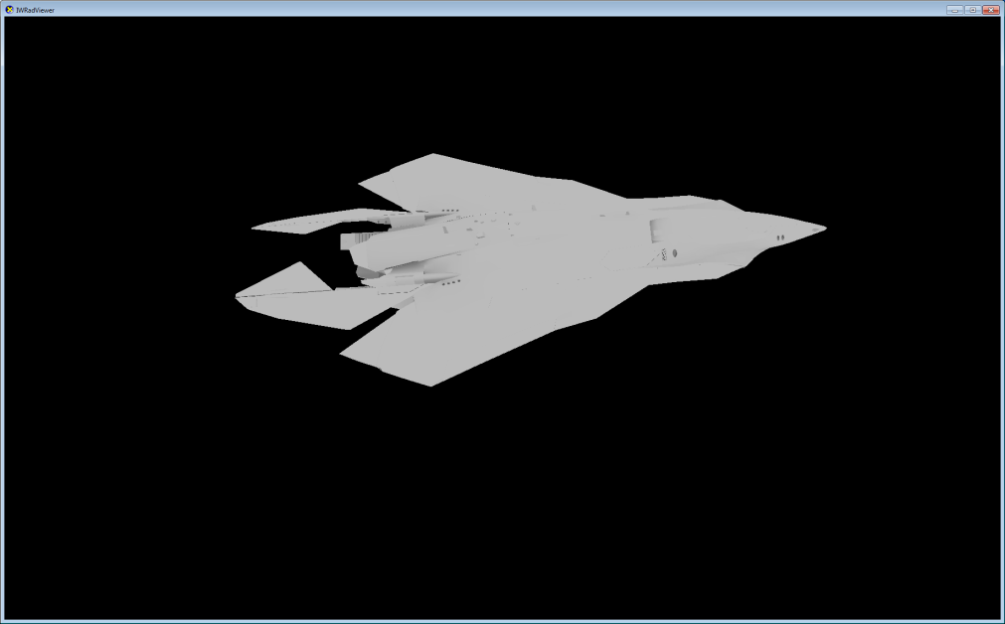
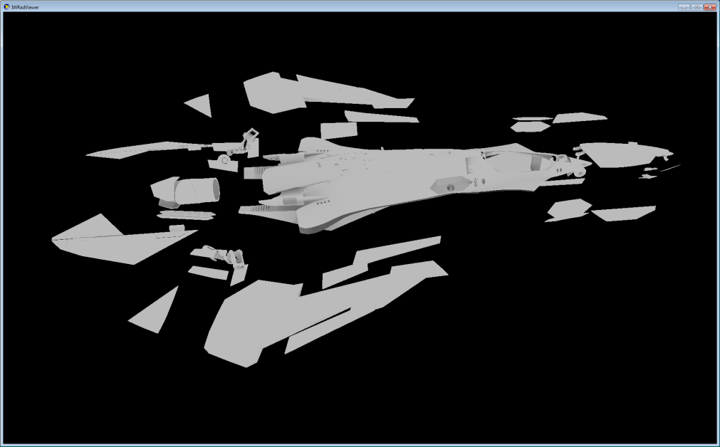
Other Self visIBILITY issues
Short rays for things like ship interiors, elevators
Rigid objects bake components separately
Doors that might open
Landing gear
Transparencies don’t occlude
But they get self-vis signal
No special handling of skinned object
Just make the baking rays shorter
Notes:
A bunch of other things to mention here – we use shorter rays for the interiors – like ship insides, elevations – generally things that the player can go into – to make sure they are not „all occluded”. For rigid elements that can move – landing gear, doors etc – we bake each of such components separately. We don't do anything for the skinned models, they are just baked in the bind pose, but we also use shorter rays, to generate less occlusion in crotch, armpits etc.

Slide 23
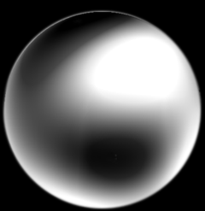
Fitting cone
Least squares fit of the cone:
Optimal linear becomes axis
Non-linear fit for angle, but only 1d
Scale is just a ratio of visibility integrated over the cone to the cone integrated over itself
d
θ
S
Notes:
Now that we have the SH visibility for every vertex, we convert it to the cone representation i mentioned before. For the axis, we use the optimal linear direction from the SH. Fitting the scale and the angle requires a non linear fitting process, but it turns out the two things are actually fairly decoupled, and you can solve for the angle first – it’s still a non linear solve, but a really simple one, as it’s only 1d – and then calculate the scale as the ratio of the visibility integrated over the cone to the cone integrated over itself.

Slide 24








Fitting cone
Baked visibility projected to SH, rotated to the frame of the cone
Scaled cone along +Z projected to SH (S: scale, α:cone angle)
Minimize the squared difference:
Partial derivatives w.r.t. degrees of freedom:
Simplifying, rearranging, using SH orthonormality:
Setting partials to 0:
Solve for α
Simple, 1d, non-linear solve
Compute S
Notes:
The math for all this is here, you can go though that later, but it’s actually pretty simple, just typical minimization of a quadratic error function

Slide 25
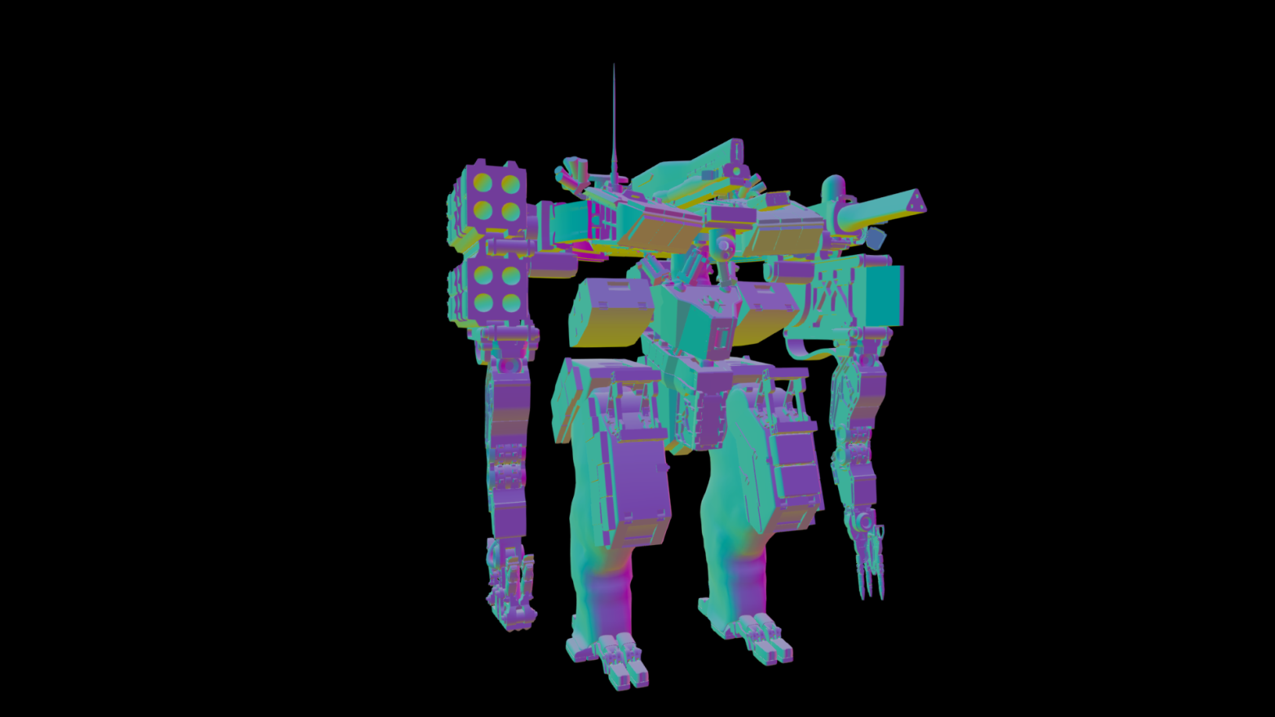
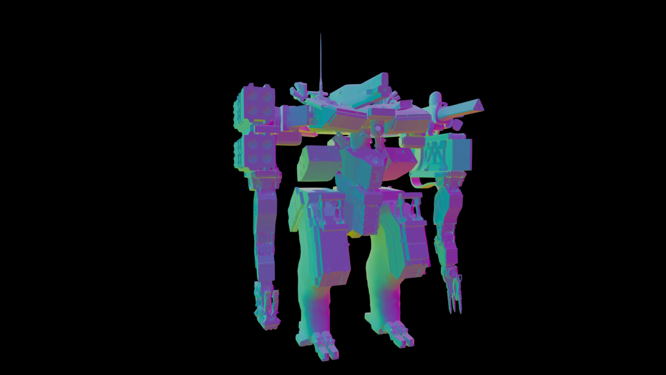
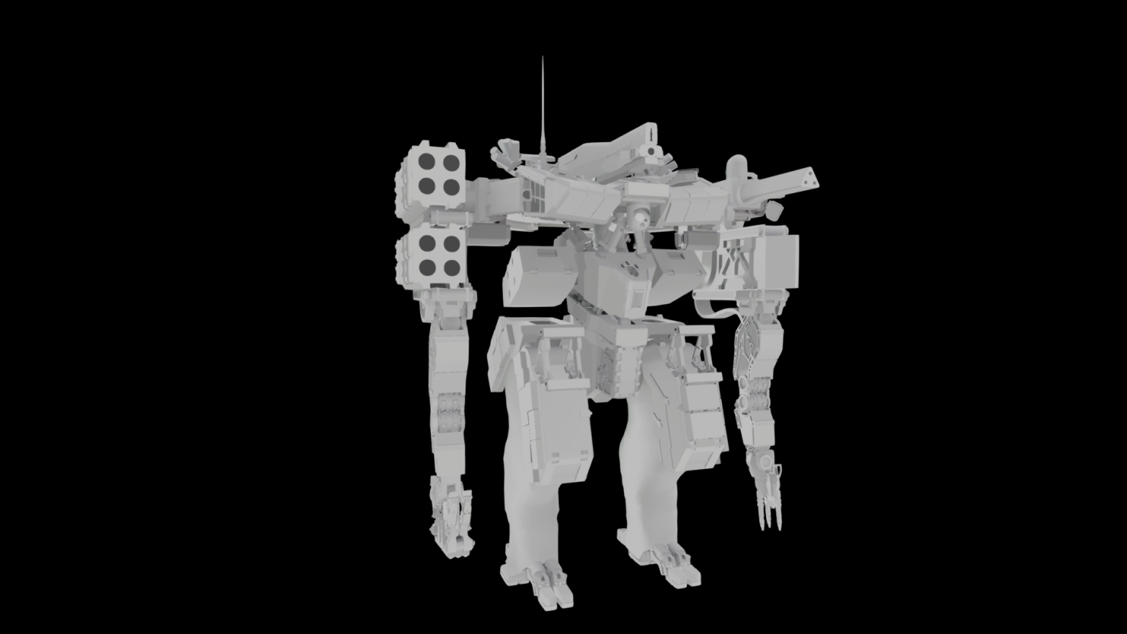
SELF VISIBILITY
Normal
Self visibility direction
Self visibility cone angle
Notes:
This is what the baked visibility looks like in debug visualization. As you can see the direction is fairly consistent with the normal – which of course makes sense – the main unoccluded direction will often be the normal direction – but in the occluded areas, like the robot armpits it deviates quite a bit. And the cosine of the angle looks fairly AO-ish – but that’s because it is a form of AO actually – if compute the AO without the cosine term, this is actually what you get

Slide 26
LIGHTING
Single lighting environment not enough
lighting can change drastically across large objects
Could to gradients [Annen2004]
Quality/cost unsatisfactory
Generate multiple sampling points
scattered around the object
number depending on object size
Store the incoming lighting at those points and intepolate it across the whole object
Notes:
Now, let’s talk a bit about the lighting. One thing that we knew immediately was that a single lightprobe for the entire object is simply not enough – lighting can change pretty drastically across the objects, especially large ones. One option would be to use irradiance gradients, which do a form of 1st order Taylor expansion of the lighting spatially, but we weren’t quite happy with it’s quality to cost ratio – as in the end, it’s still just one probe.
So for each object we actually use multiple sampling locations for the lighting – we scatter them around the object, with their number depending on object size – and we interpolate the lighting from those points across the whole object

Slide 27
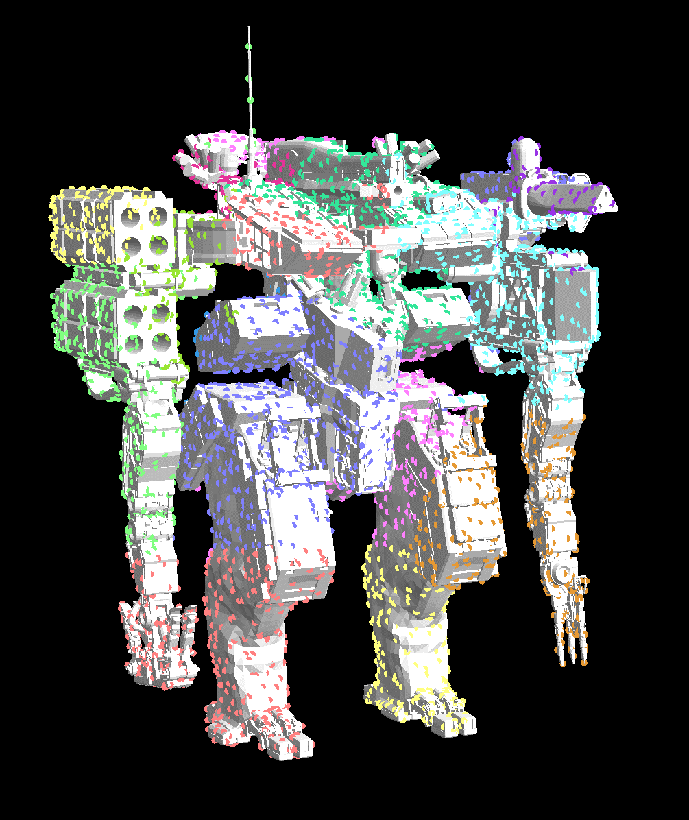
DETERMINING SAMPLING POSITIONS
Figure out N - the target number of probes – based on object size
Sample object geometry uniformly, fairly densly
Perform k-means clustering to assign samples to N clusters
Final cluster centers after relaxation become sampling positions
Notes:
We figure out those sampling positions automatically. We first figure out how many we need – and this is just a heuristic based on object size. Then we sample the object uniformly and perform a k-means clustering to group those sample to N clusters. After few iterations, the centers of the final clusters become sampling positions.

Slide 28
INTERPOLATING the LIGHTING
Compute the covariance matrix of the set of sampling positions
Relative magnitudes of the eigenvalues determine interpolation mode
Eigenvectors define local space for interpolation
Notes:
Given the set of sampling points we figure out the interpolation mode. For that we compute the covariance matrix of the set of sampling points and extract its eigenvalues and eigenvector. The structure of those determines how we perform the interpolation – the relative magnitude of the eigenvalues determines the interpolation mode and the eigenvectors form a local space in which the interpolation happens

Slide 29
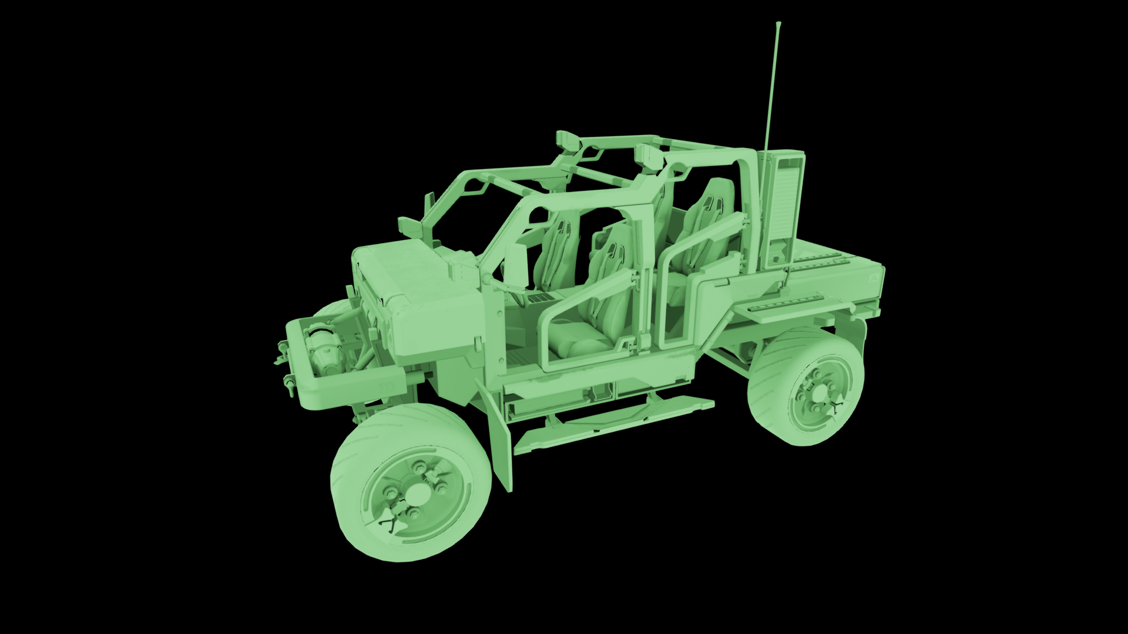
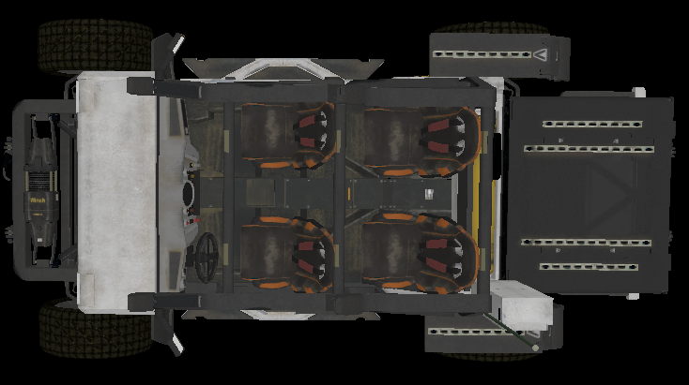
Single PROBE
Notes:
And this is what we mean by that. If there’s only one probe for the whole object it’s simple – whole object just uses the probe.

Slide 30
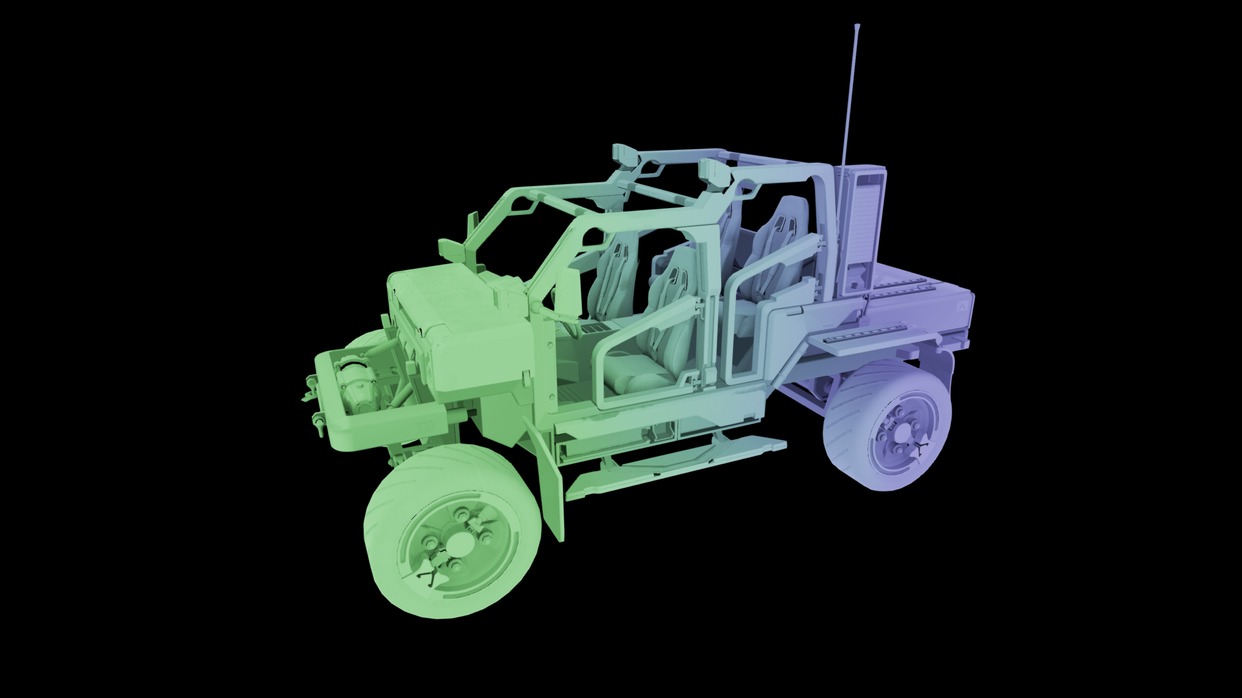
1D Interpolation
Notes:
If we have more, but the there’s only one large eigenvalue it means that the sampling locations form a line. Each point on the object can be projected to that line and use the two closest probes to get the lighting, by interpolating between them. Here, we have only two probes, but if there was more and they still formed a line, they would also use the 1d interpolation mode

Slide 31
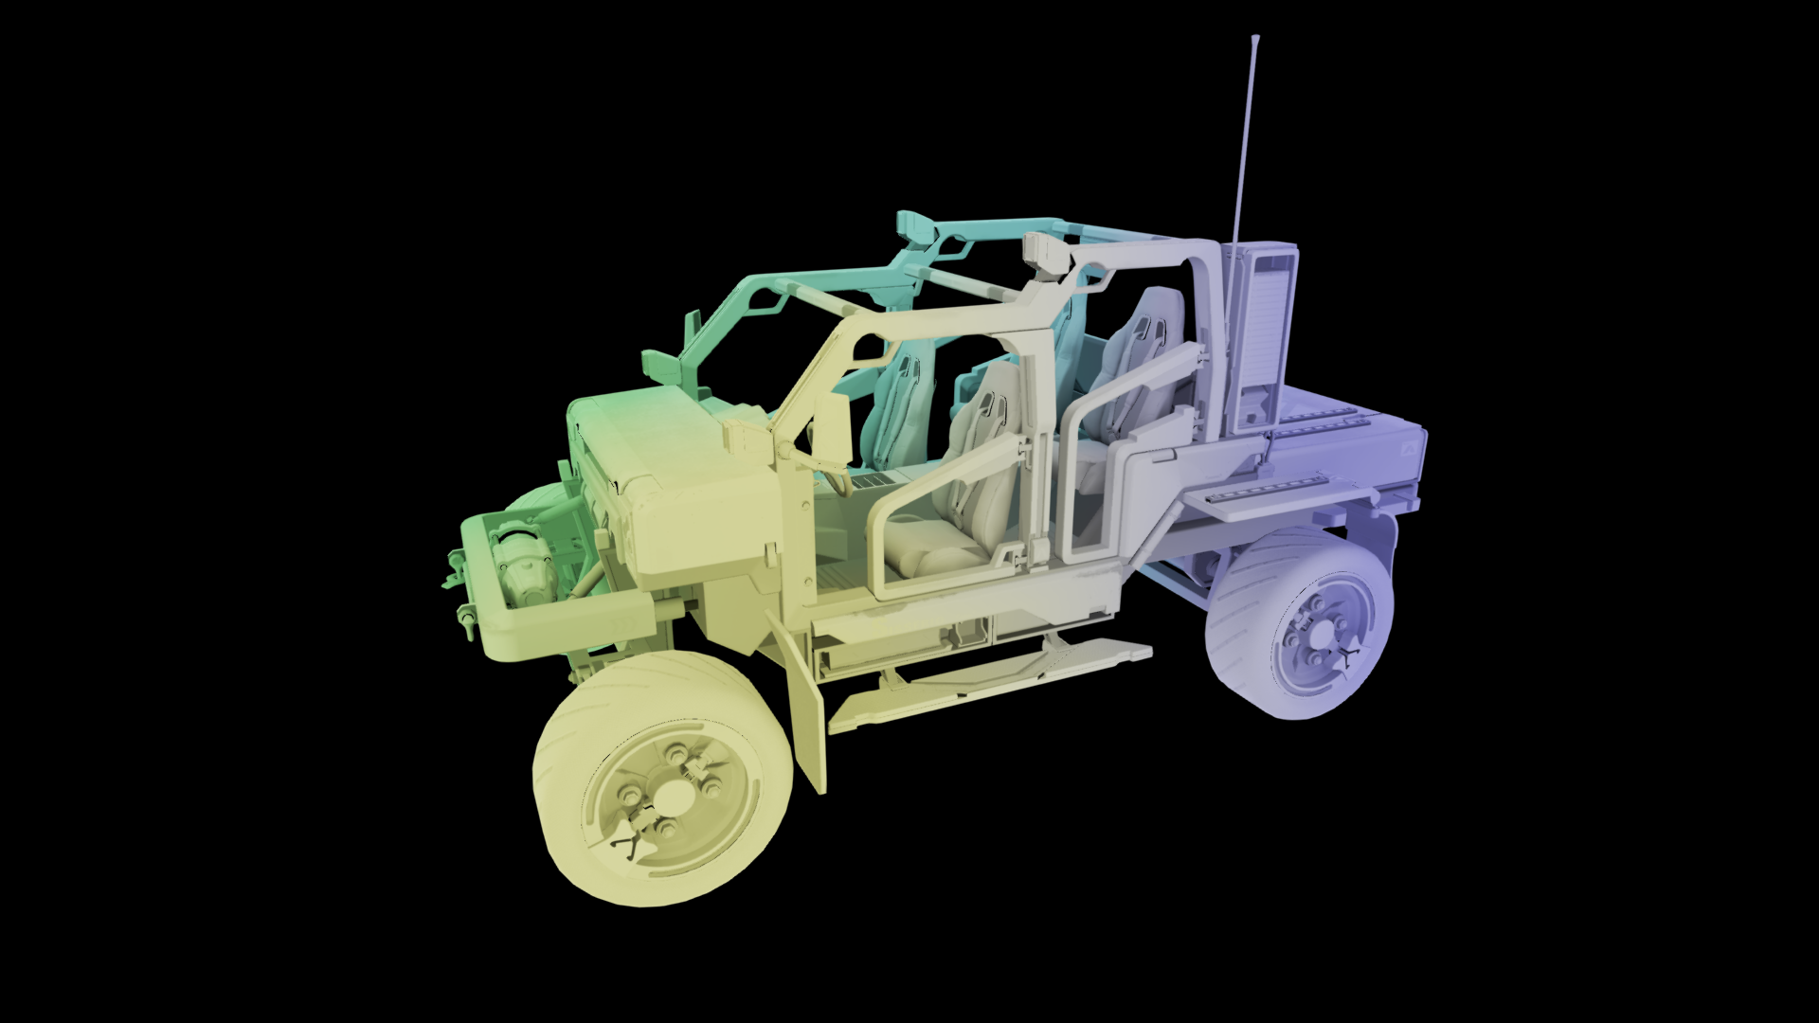
2d Interpolation
Notes:
If there are two large eigenvalues, the sampling points form a plane. So we project everything onto this plane, triangulate the sampling point set and each point on the object uses the three probes that are the vertices of the triangle it projects to.

Slide 32
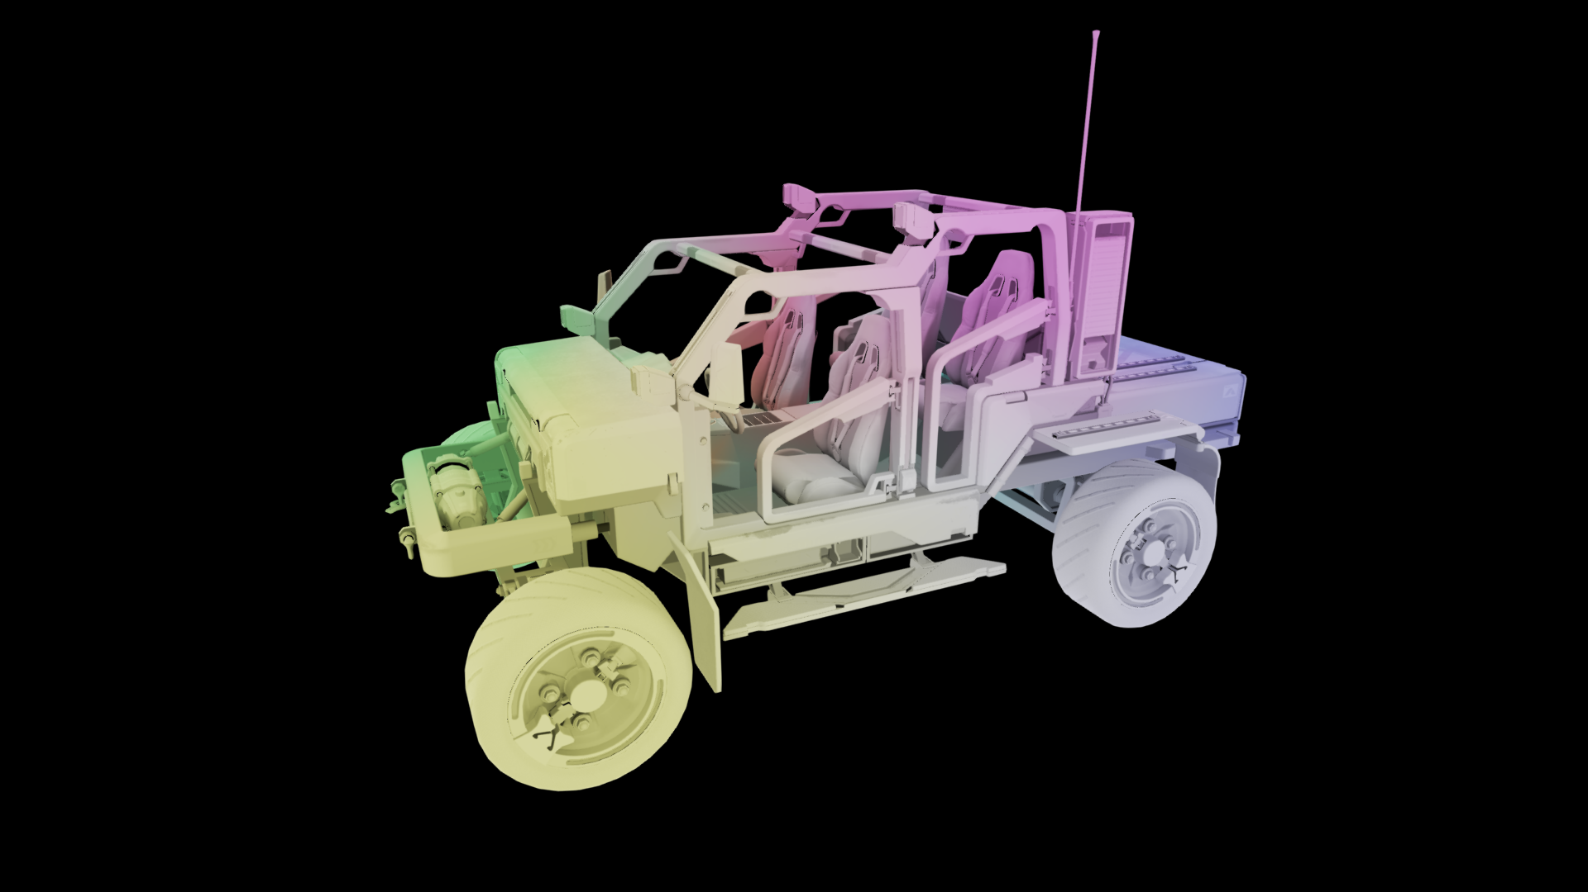
3d Interpolation
Notes:
If all three eigenvalues are large, the probes just form a 3d cloud – which we tetrahedralize, and each point on the object uses 4 probes – the vertices of the tet it’s in – to get the lighting.

Slide 33
InterpolatiNG the lighting
Generate Delauney mesh with a given dimensionality
Classify each vertex of a mesh to one simplex
Store:
indices of the samlping points
interpolation weights
2 x 4 bytes per vertex – shared between instances
Skinned objects can explicitly attach sampling positions to particular bones
Notes:
So to summarize, we generally generate Delauney mesh of a given dimensionality and classify each vertex of a mesh to one of the generated simplexes. We do it offline, and for each vertex of a mesh, we store the indices of the probes that a given vertex uses together with the interpolation weights. This is stored as two time 4 bytes per vertex – and again, this data is shared between instances.
Additionally, skinned objects can bypass all that and explicitly attach sampling positions to particular bones.

Slide 34
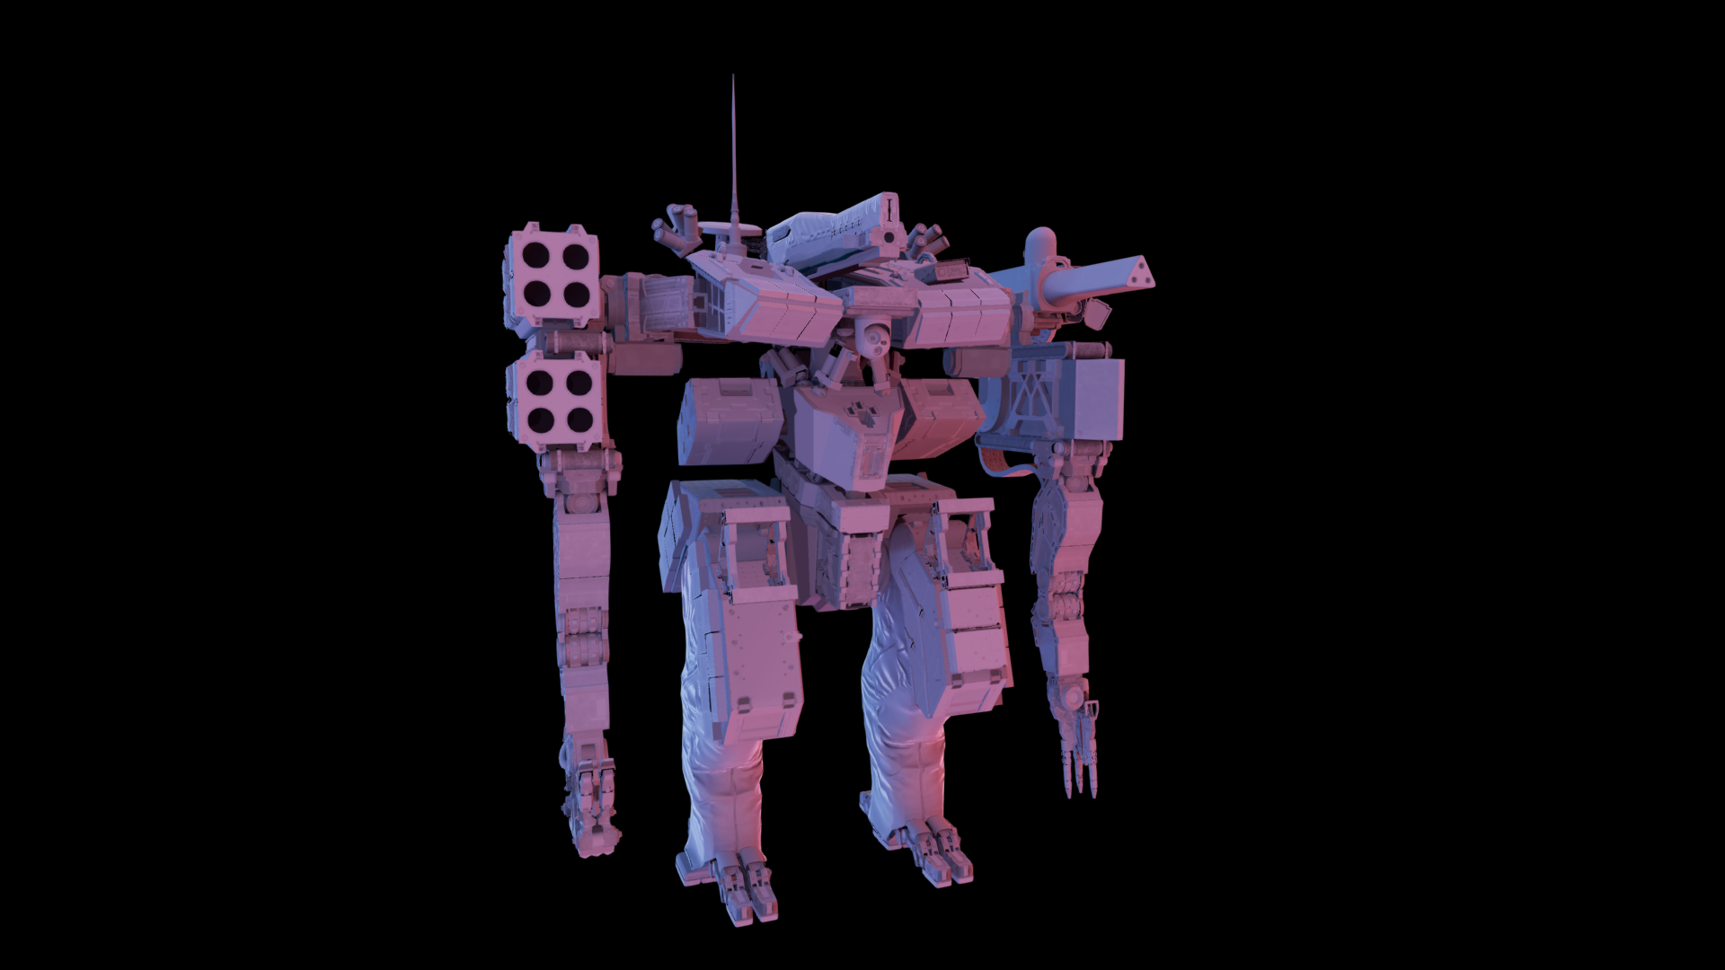
SINGLE PROBE
Notes:
To show you the difference between using single probe and multiple probes – this is an object lit with a single probe.
Even though it’s a single probe, if you look at those two thingines in the center of the robot’s body, they are lit differently – even though they are oriented the same way. This is what directional visibility gives you – those elements are mostly occluded in opposite directions, the light on that side gets removed with the visibility multiply and you still get different lighting

Slide 35
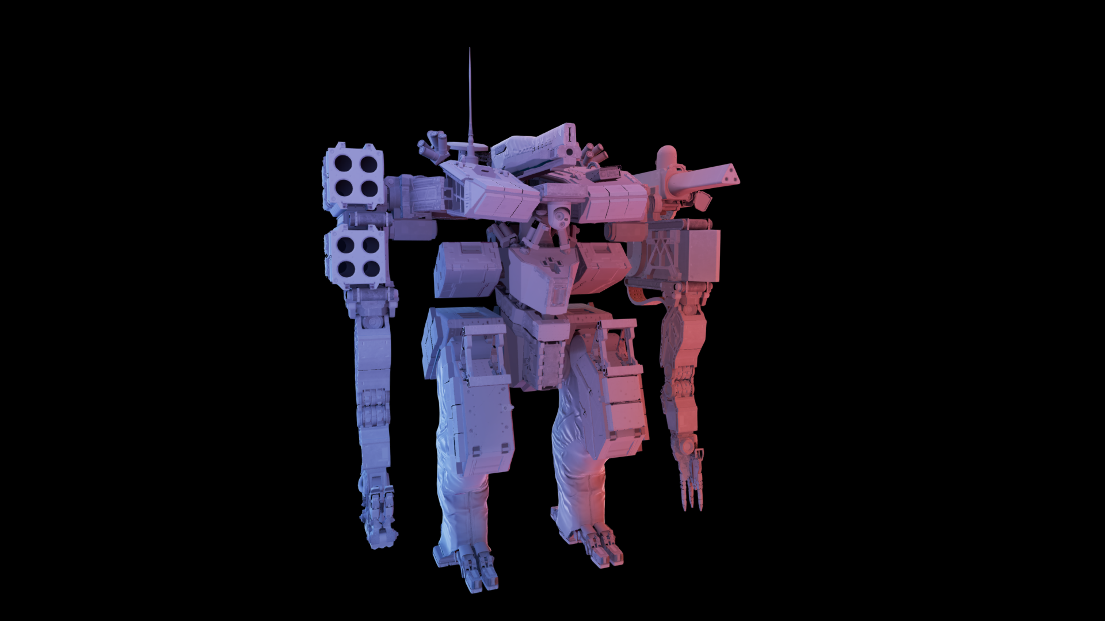
MULTIPLE PROBES
Notes:
This is the same object lit with multiple probes – you get that color gradient going from left to right that wasn't there before. This might not really be that super important for that robot here, as it’s fairly small, but we use the same method to light much larger objects too, and this is where the technique shines

Slide 36
SINGLE PROBE
Notes:
This is single probe again

Slide 37
RUNTIME PART
Determine lighting for sampling points:
Static geometry has it baked
Dynamic geometry samples from the volumetric structure
Vertex shader:
Grabs the sampling point indices and weights
Interpolates the lighting
Combines it with self-visibility to get occluded incoming lighting at given vertex
Encode it to AHD and pass to pixel shader
Pixel shader:
A + saturate(n.D)*H
Notes:
The runtime part is mostly fairly straightforward – we gather the sampling points for the visible objects, determine lighting at those points – for static geometry we just have it baked, for dynamic ones we sample the volumetric structure that stores the lighting for the level. Now, the vertex shader grabs the indices of the probes that should be used at a given vertex, the weights, does the interpolation, combines the lighting with the self-visibility that we talked about before. The result is still a spherical function, but we need to pass it to the pixel shader, so we encode it as an AHD, and the pixel shader just does a + n.l

Slide 38
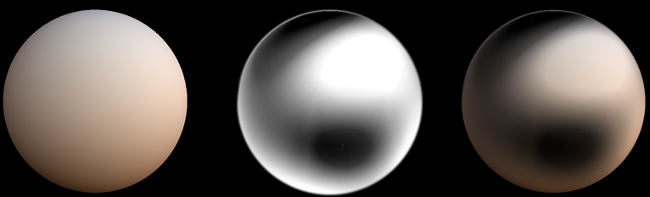
TRICKY BIT
Combining lighting with self visibility
Want to mask parts of the probe that are occluded
Multiply lighting by visibility
*
=
Lighting
Visibility
Occluded lighting
Notes:
The only tricky part in all that is combining lighting with visibility. Because we want to mask parts of the lighting that are not visible – so we want to multiply the lighting by the visibility, just like in the rendering eequation earlier.

Slide 39
SH MULTIPLICATION
Both lighting and visibility end up as 3rd order SH
SH multiply != component-wise multiplication!!!
Initially 3rd order multiply
Lighting rotated to the cone frame – cone axis pointing along +Z
Cone projection is just ZH – multiplication *way* simpler
Convert to AHD in that space
Rotate D back
Mix different orders:
2nd order visibility * 3rd order lighting (no need for rotations)
3rd order visibility * 3rd order lighting for DC, 2nd order visibility * 3rd order lighting for remaining bands
Notes:
Both visibility and lighting end up as 3rd order SH, and the problem is that SH multiply is not a component-wise multiplication. It’s way more involved, coefficients get all intermingled. Initially we did however implement that – we took the lighting, we rotated it to the frame of the cone – where the projection of the cone is just a ZH, so the multiplication is way simpler, we converted the result of the multiply to AHD in that space, then rotated D back – and it all worked really well, we had it in that form for quite a while, but it could be cheaper
Then we realized that we can do mixed order multiplies – for instance do second order visibility and 3rd order sh – where a lot of the math simplifies, or you can do full 3rd x 3rd order for the DC component – as it’s only a big dot product- and the remaining band as 2nd order x 3rd order

Slide 40
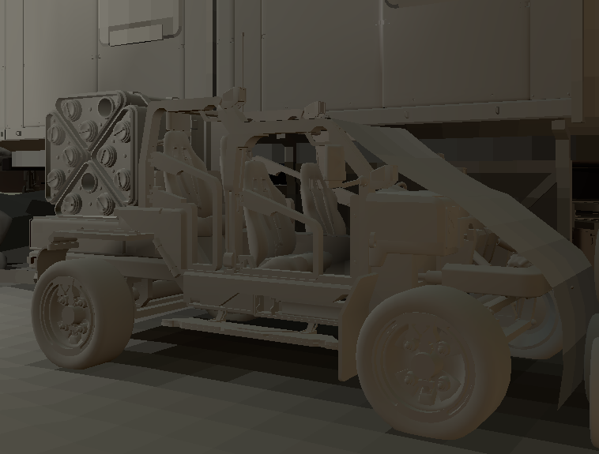
No Self VisIBILITY
Notes:
This is the comparison.

Slide 41
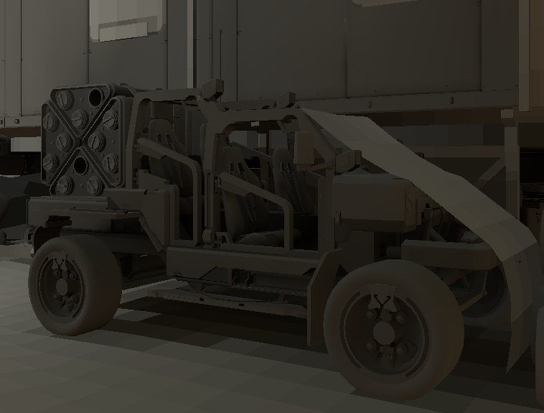
DC Visibility TIMES Light

Slide 42
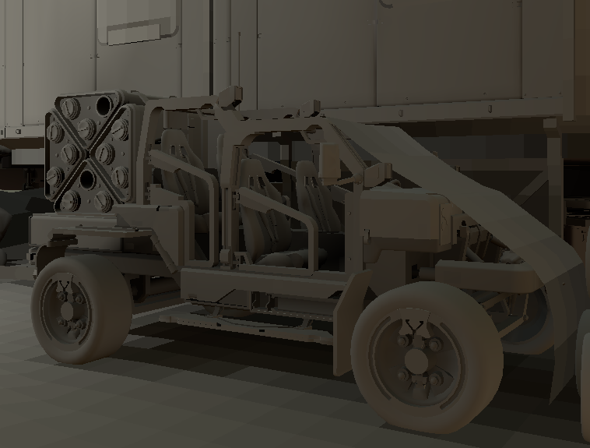
Linear Vis Multiply

Slide 43
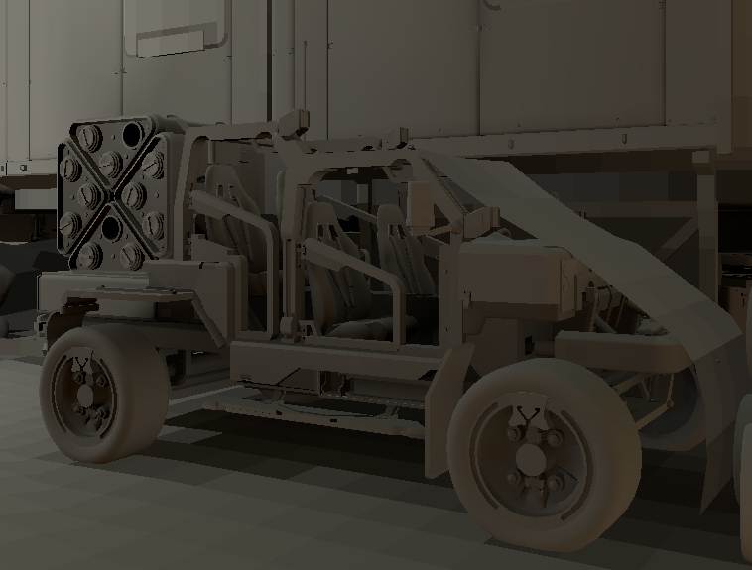
Full DC product Linear rest

Slide 44
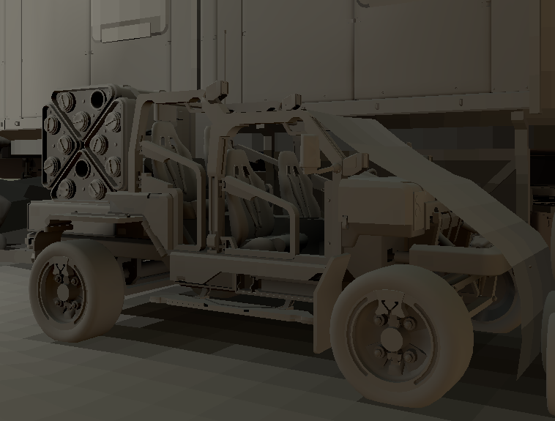
Full Product

Slide 45
GCN NOTE
GCN tweaked for a particular balance between VS and PS workloads
VS expexted to finish XXX cycles after being launched
Will stall rasterizer otherwise
Might not be a problem if enough PS work already pipelined
it was our case
YMMV
on the next project we actually move a lot to pixel shaders due to different characteristics of the geometry
And also use different basis – see Ambient Dice for details [Iwanicki17]
Notes:
One thing to note here is that it all happens at the vertex shader level. And the GCN – the gpu architecture used in the current generation consoles – was tweaked for a very particular balance of workload between vertex and pixel shaders. Vertex shaders are generally expected to finish x number of cycles after being dispatched, where x depends on different factors, like vgpr usage, parameter cache usage and so on. But the bottom line is that if they are not back on time, they will stall the rasterizer. It might not be a big problem – it wasn't for us here – if there’s already enough of the PS work scheduled to cover that stall. But your mileage may vary – for instance on the next project we have different characteristics of the geometry that’s rendered, and we actually had to move parts of that math to the pixel shades to save perf – things are done a bit differently, we use Ambient Dice as the representation of the lighting which we talked about during EGSR - but all this is a topic for another talk.
This was also one of the motivations for using discrete sampling points for the lighting and interpolating the data by hand, instead of using 3d textures for instance and hardware interpolation. Because the vertex processing pipeline is so sensitive to latency, we use the scalar memory path as whenever possible, which has much lower latency of the lookup. Using texture wouldn’t allow us to take advantage of such optimizations and decrease the overall performance.

Slide 46
LIGHTING
We know how to interpolate the lighting an combine it with visibility
We just need to know *what* that lighting is
Two options:
Dynamic geometry: sample from light grid
Static geometry: bake
Notes:
Now we know how to interpolate the lighting, how to combine it with the visibility, we just need to know what the lighting is.
And there are two options here – for static objects we bake it – and Peter-Pike will talk about some details on that – but for dynamic objects, we sample a volumetric data structure that i’ll talk a bit now.

Slide 47
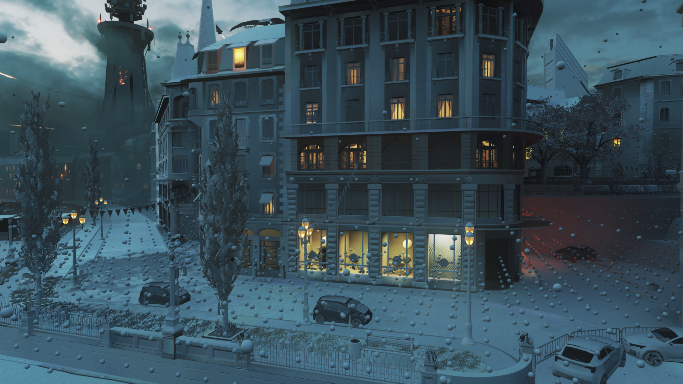
LIGHT GRID
Light grid: our volumetric structure that holds the indirect lighting for the level
Used by:
dynamic objects
volumetrics
VFX
Designed to be accessed from GPU
couple tens of thousands of lookups per frame
Notes:
We call that structure light grid, it’s being used by the dynamic objects, but also volumetrics, visual effects, decals. It was designed to be accessed from the GPU, but in the order of tens of thousands times per frame, not really per-pixel. Our motivation was that as the lighting becomes more complex, the data becomes more complex too, and it’s more costly to perform the lookup – but the data, if you decouple the high frequency components – is fairly smooth – so there’s no need to pay the lookup cost for every pixel – and we should rather resample to simpler representations to mitigate that cost – like those discrete sampling points i was talking about earlier

Slide 48
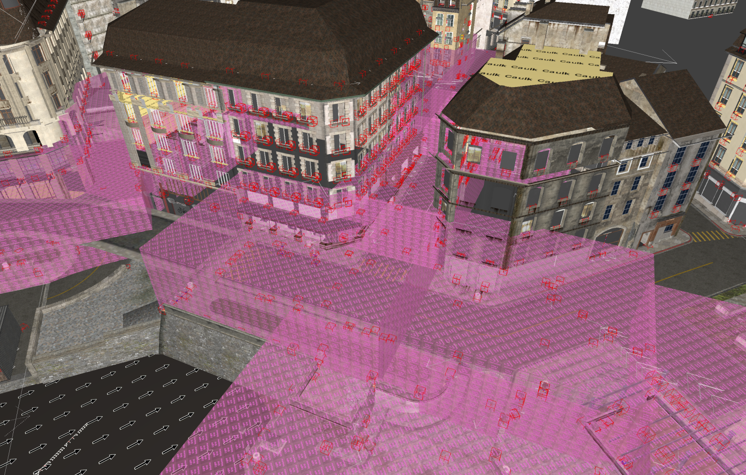
LIGHT GRID
Don’t want to manully place probes
Previous system relied on manualy placed volumes
re-use those
Notes:
We knew that we didn't want the artists to place the probes manually. The previous system that we had relied on manually places volumes that enclosed the regions of interest and we decided to re-use them

Slide 49
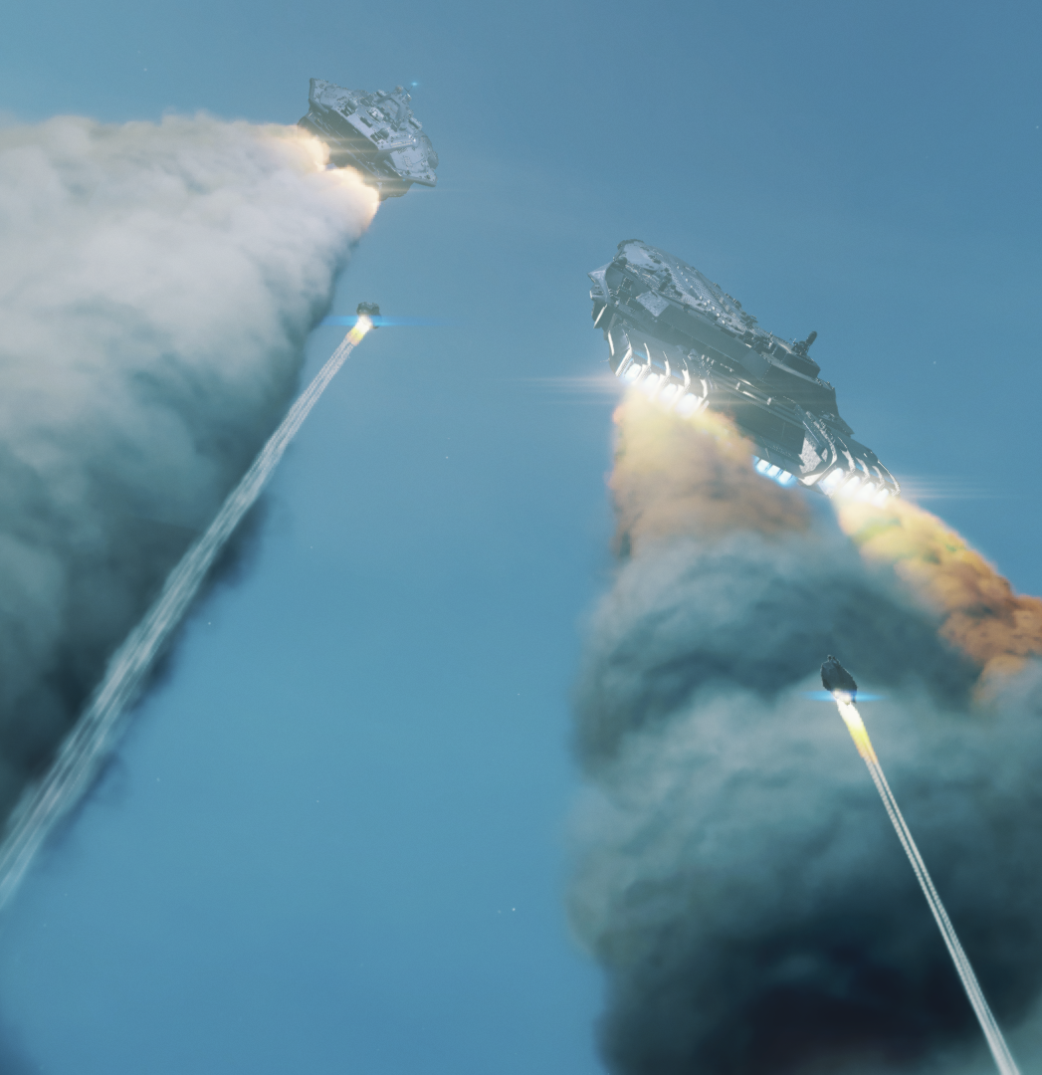
LIGHT GRID
Cannot just place uniform grid inside them
Transitions from ground to space – huge volumes
Too many probes even without that
Non-uniform distribution of probes and tetrahedrization of the set [Cupisz12]
Trivial to interpolate, C0 continuity
Only 4 values to interpolate between
Notes:
But we couldn't just uniformly place probes in them – we have those transitions into space, the volumes can be pretty large. So we settled on a non-uniform distribution of probes and a tetrahedrization of that set – much like solution that Robert talked about during GDC few years back. Tets are good, because you only have 4 values to interpolate between and the result is C0 continuous.

Slide 50
LIGHT GRID
Generate sampling points near geometry, some in empty space, generate tets out of this
Eeee.... no
Delauney tetrahedrization finicky semi-random point sets
lot of long, thin tets
They create nasty artifacts at runtime
Tried a lot of different ways to fix them
Add extra points near bad tets
Move the exising ones to be less bad
The conclusion was that tets can do a decent job if they are fairly regular
Notes:
So we did this with some probes that we generated fairly randomly near geometry – and it didn't really work well. Delauney tetrahedrization is fairly finicky when it comes to such random point sets – you end up with long, skinny tets, that behave really bad at runtime, generating temporal artifacts. And we spend a fair amount of time trying to fix them in various ways, but the bottom line was that tets can do a decent job pretty much only when they are fairly regular.

Slide 51
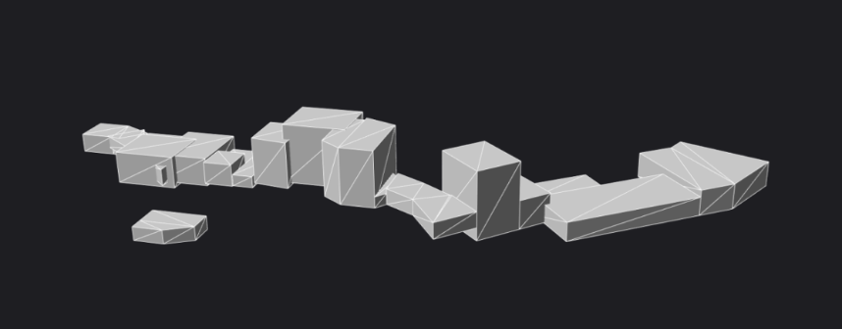
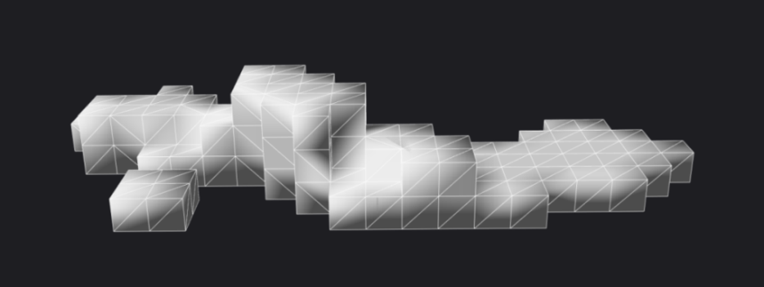
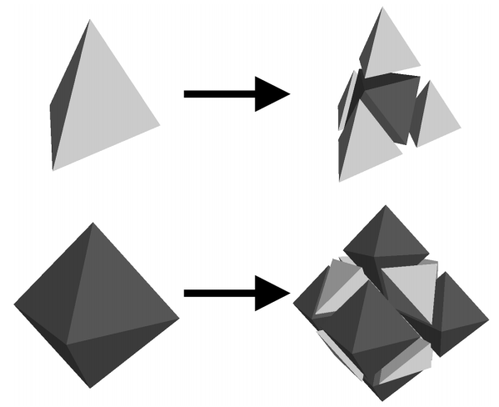
Light GRID
Start with tets that are good
...and try not to mess them up too much
Start with *very* rough voxelization of level’s volumes
Tetrahedralize voxelization
Only boxes in input = nice and regular tets
Subdivide tetrahedrons
Scheme from [Schaefer04]
Tet -> 4 tets + oct
Oct -> 6 octs + 8 tets
Ensure that neighbors are at most 1 subdivision level apart
Subdivide near geometry, navmesh, manually placed regions of interest
Notes:
So the idea was to start with tets that are good and not mess them up.
We take the volumes that artists placed, we generate a very rough voxelization of that. Those are only boxes, so the tets end up nice and regular. Next we subdivide them, according to the scheme by Scott Schaefer – where a tet gets split into 4 tets and octahedron, and octahedron gets split into 6 octahedrons and 8 tetrahedrons – all of them fairly close to being half of the size of the initial cell. And during that subdivision, we ensure that two neighboring cells are at most 1 subdivision level apart – which ensures that are no badly formed cells. And we subdivide near geometry, navmesh, manually placed regions of interest.

Slide 52
LIGHT GRID
Compute the rough lighting of the points at the bottom of the hierarchy
For each subdivision in the hierarchy compute the error
squared difference between interpolated lighting at a given level and one level lower
analitically: integrals over the volume of the cell
Starting from the top of the hierarchy refine again
Refinement priority based on the error, proximity to areas of intereset etc.
Final set of points is regular and aligns with both geometry and with signal
The cells are not tets however – just re-mesh
Notes:
This creates a lot of points at the very bottom, way too many for use. So we compute the lighting at the bottom of that subdivision hierarchy, then for each subdivision we compute the error – the squared difference between the lighting interpolated at a given level and the lighting computed using the data from one level lower. And then, starting from the top of the hierarchy, we subdivide again, this time with a heuristic that relies on that error – and things like distance to regions of interest, still conforming to that „neighbors being 1 level apart” rule. In the end, we get a set of points that’s really regular, and aligns with the geometry as well as with the lighting signal. The cells are not only tets however – as we generate those octahedrons too – but we just take the resulting probes and re-mesh them.

Slide 53
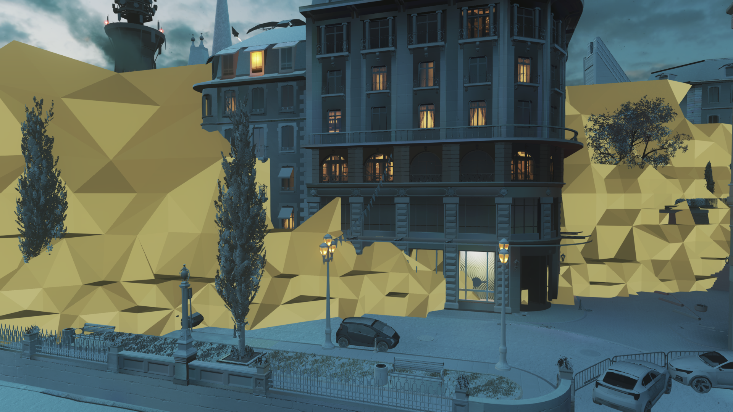
Tetrahedral Mesh
Notes:
This is what it looks like – just a cut through the tet mesh, the edge of that cut is being shown – as you can see the density changes, but in a smooth fashion – and in the areas where the player moves the density is higher

Slide 54
LIGHT GRID
Notes:
This is the resulting set of probes

Slide 55
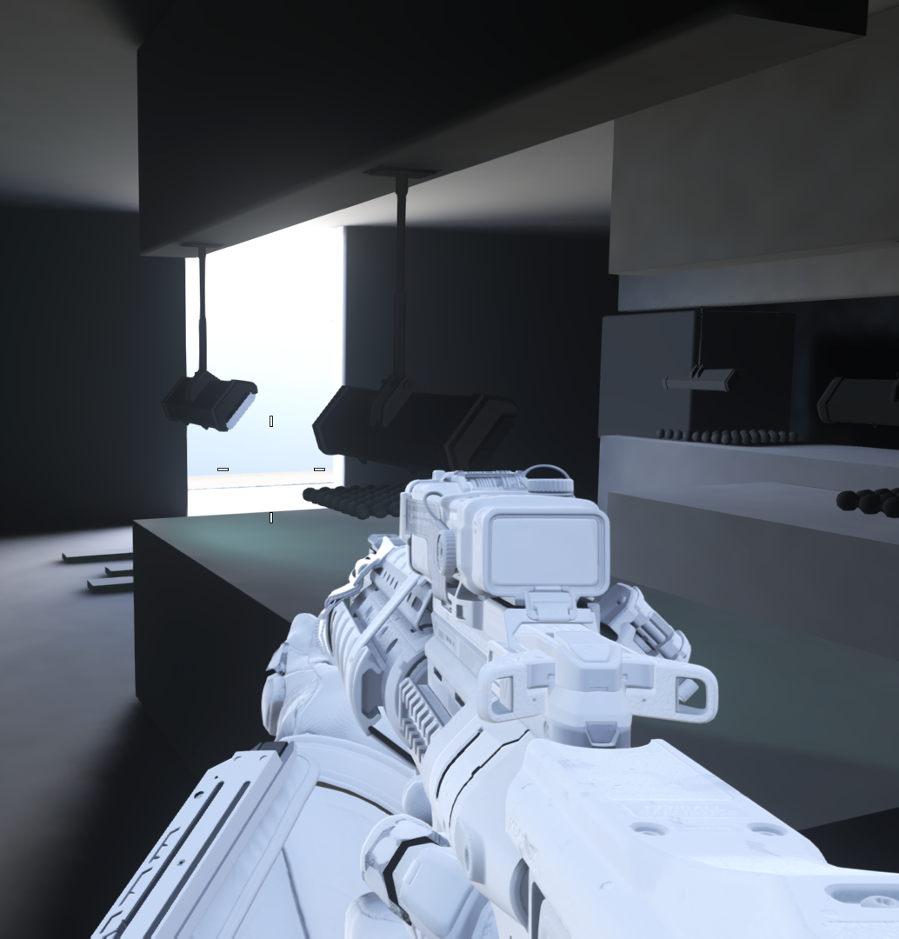
LIGHT GRID VISIBILITY
Lighting bleeds through walls ☹
Probes used even when not visible from lookup position
Augment probes with some visibility information to limit their influence
For each probe, for each tet it touches store a triangular depth map
Store barycentric of the first intersection: 0-1 range
Notes:
The only thing that’s left is the visibility – if we just interpolate the lighting between the probes the lighting will bleed through walls – you’ll lighting from the outside in the insides and vice versa. So our solution is to augment the probes with some visibility information to limit their influence. For each probe, we store a triangular depth map that stores the barycentrics of the first intersection on the ray to the opposite triangle

Slide 56
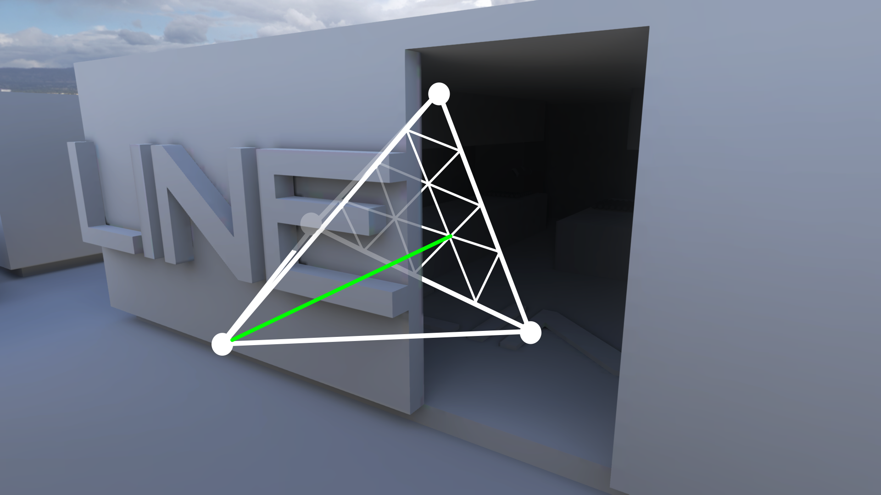
GENERATING VISIBILITY
Notes:
This is an graphical example, looking a the probe on the left, we shoot a ray towards opposite face of the tet, it doesnt hit anything so we store 1.0

Slide 57
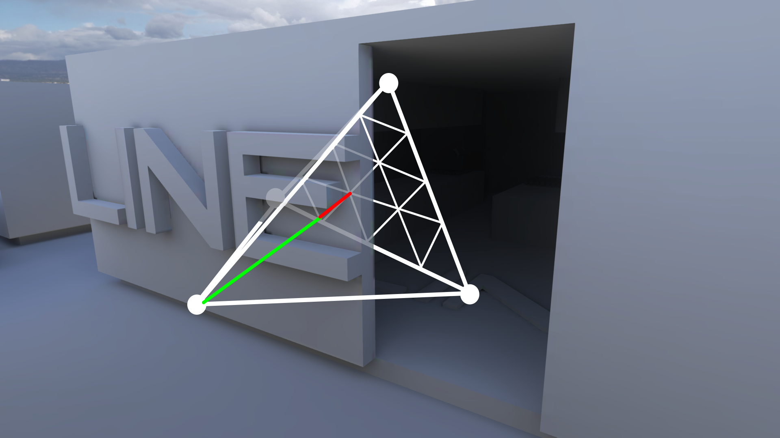
GENERATING VISIBILITY
Notes:
We shoot another ray, it hits something, so at that location we store something like 0.6

Slide 58
LIGHT GRID VISIBILITY
Store 15 points, 8 bits of precision
4 DWORDs total
On finest subdivision level that gives us 2 bits per unit – more than enough
1
1
1
1
0.6
1
1
1
0.7
0.5
1
1
1
0.6
0.4
Notes:
And we end up with that triangular depth map. We store 15 values, with 8 bits of precision, so total everything fits into 4DWORDs. And the precision, even though it might sound low, is actually more than enough – we get like 2 bits per unit on the finest subdivision level – and our unit is around 1inch.

Slide 59
ACCESSING VISIBILITY DATA
float GetDepthForTetrahedronProbe( float2 bary, uint4 encodedDepth )
{
float sampleY = floor( bary.y * 4.0f );
float sampleX = floor( bary.x * 4.0f );
int baseIndex = (int)( ( ( 11.0f - sampleY ) * sampleY ) * 0.5f + sampleX + 0.5f );
int lineLength = 5 - (int)sampleY;
float2 baseBary = float2( sampleX * 0.25f, sampleY * 0.25f );
int3 indices = int3( baseIndex + 1, baseIndex + lineLength, baseIndex );
float3 sampleBary;
sampleBary.x = ( bary.x - baseBary.x ) * 4.0f;
sampleBary.y = ( bary.y - baseBary.y ) * 4.0f;
if ( sampleBary.x + sampleBary.y > 1.0f )
{
// above the diagonal
indices = int3( baseIndex + lineLength, baseIndex + 1, baseIndex + lineLength + 1 );
float3 newSampleBary;
newSampleBary.x = -( sampleBary.y - 1.0f );
newSampleBary.y = -( sampleBary.x - 1.0f );
sampleBary = newSampleBary;
}
sampleBary.z = 1.0f - sampleBary.x - sampleBary.y;
float result = 0.0f;
for( int i=0; i<3; ++i )
{
uint currIndex = indices[i];
int intDepth = ( encodedDepth[currIndex / 4] >> ( ( currIndex % 4 ) * 8 ) ) & 0xFF;
float depth = (float)intDepth / 255.0f;
result += sampleBary[i] * depth;
}
return result;
}
Notes:
This is the code to access that data from those 4 dwords based on the barycentrics, really simple, you can go through that after

Slide 60
LIGHT GRID RUNTIME
Simple async jobs looks up lighting in the light grid
Bootstrap tetrahedron search with:
tetrahedron used in previous frame
voxel tree – piggyback on structure used for other purpose – add a good starting tet to each node
Walk across tets until all barycentrics are in [0..1]
otherwise move in the most negative direction
see [Cupisz12] for details
Grab the probes, compute interpolation weights, mask by visibility if needed, interpolate, write out
Notes:
The runtime part is fairly straightforward again – async running somewhere in the background early in the frame. We bootstrap the tetrahedron lookup with a tet index used in previous frame or if it’s not availble we have a fallback start tet in a data structure used for other purposes – we piggybacked on that. The search is a simple walk through the tests, evaluating the barycentrics until they are in 0-1 range – just like Robert described. Once we get to the proper tet, we grab the lighting, evaluate the visibility of the probes, interpolate and write out the result

Slide 61
LIGHT GRID RUNTIME
Ended up adding slight temporal filtering of sampled lighting
Smooths lighting for fast moving objects
Total of ~100k probes/level
~60 MB for all the data
All the lookups take ~0.2-0.4ms
But it’s only a handful of wavefronts
They just hide somewhere in the early part of the frame
Notes:
Few notes: we ended up using some slight temporal filtering on the output lighting – fast moving objects can flicker in some cases without it.
Target number of probes per level is around 100k, it all takes around 60 MB total – a lot of that data is actually visibility information, which could be compressed in some simple ways, but we never got to that. The lookups take on the order of 0.2-0.4ms, but it’s only a handful of wavefronts, so when run on async pipe, they just hide somewhere and are virtually free.

Slide 62
Baking

Slide 63
General baking
Standard-ish baking algorithms (Embree for RT)
Decouple indirect from self-vis for vertex bake
Support emissive/point/line lights
Validation + in-painting for “stuff jammed in stuff”
De-noising
Non-lightmapped objects bounce light via probes
Seam solving for charts
…
Notes:
There are a lot of things we do in our baking pipeline that I am not going to talk about here. I will just focus on how we sample lighting for the new data Michal talked about (lightgrid and static models with decoupled visibility), how we “de-ring” spherical harmonics and discuss lightmap encodings and the algorithm we use to project into AHD.

Slide 64
Hemispherical basis
Quadratic SH is over-kill
Ambient Cube [McTaggart04]
Fast, 3 coefficients, can struggle with seams
Decompose SH to ambient and directional light is common
[Chen08][Lazarov13][Iwanicki13]
H-Basis (linear SH least squares over hemisphere) [Habel2010]
Better bounce, but less directionality
Eigenfunctions from Gramm matrix of SH over hemisphere
Notes:
There are a lot of potential basis functions that can be used to encode lightmaps. We have investigated several of them, but ended up using AHD. The one we considered the most carefully was the H-Basis, which is equivalent to least squares projecting quadratic spherical harmonics to linear spherical harmonics over the hemisphere.
One new family of basis functions we looked at is a generalization of the H-basis. If you take any set of basis functions, say spherical harmonics, you can build the Gramm matrix over a domain (integral of pair of basis functions over the domain – hemisphere in our case, orthogonal basis have an identity Gramm matrix) and take it’s eigen vectors. The linear combination from the coefficients of each eigen vector represents a new basis function (some of quadratics for example), and using K of them you can do better than the H basis in general.

Slide 65
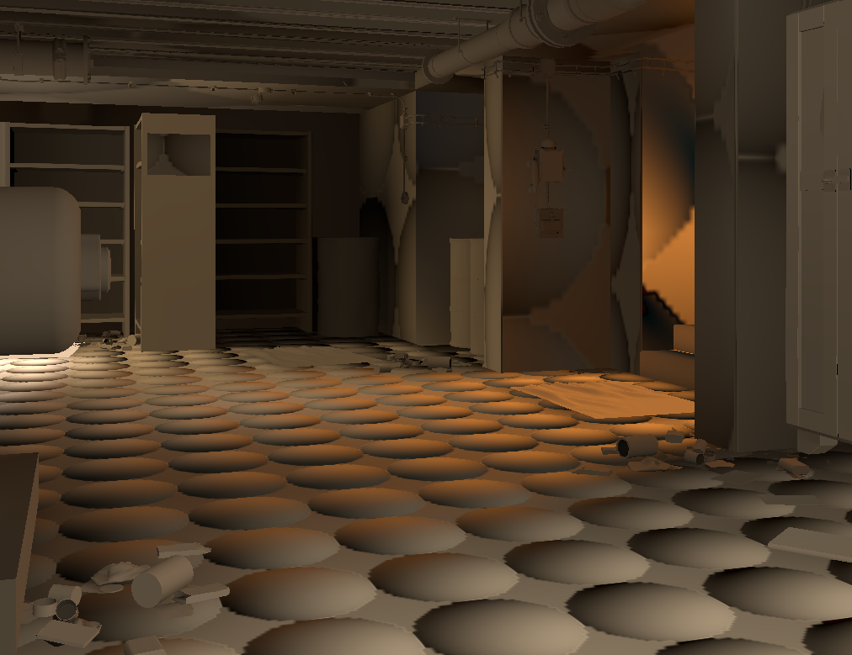
SH3
Notes:
Here is quadratic spherical harmonics, impractical, but the input for all the other basis. This lighting environment has a mix of directions, which makes it a tough case for AHD.

Slide 66
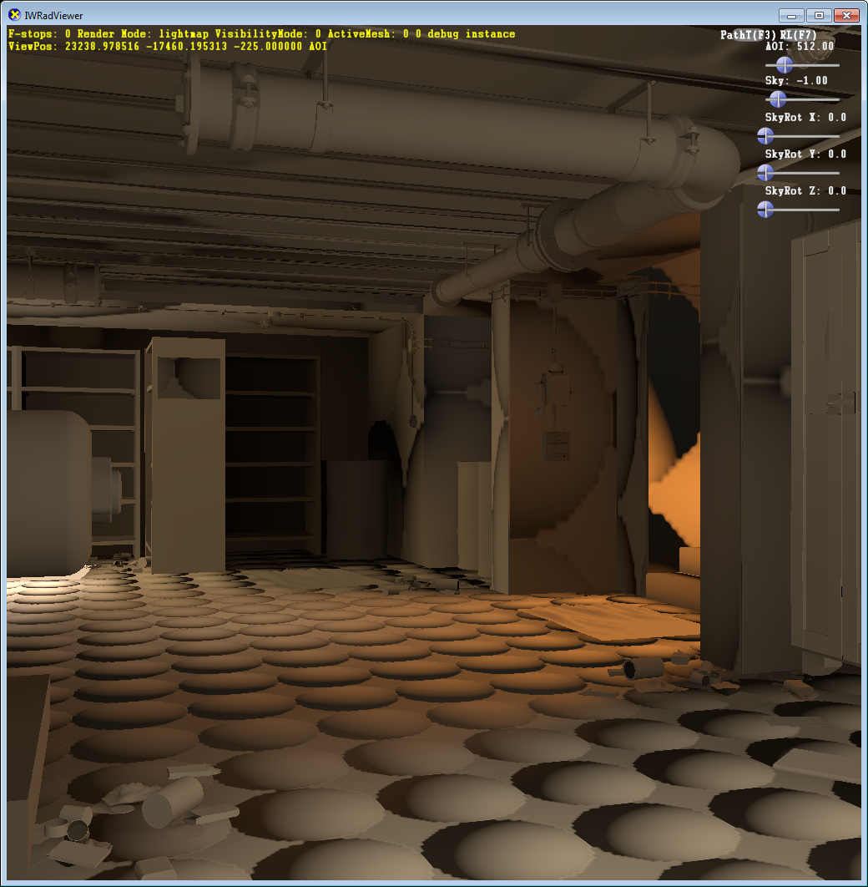
AHD
Notes:
AHD has high contrast, the strong shadow terminator is obvious on the bottom of this image. This makes normal maps have higher contrast, and is something our lighters like. Since it only has a single direction, it can struggle with color bleeding if they are from different directions.

Slide 67
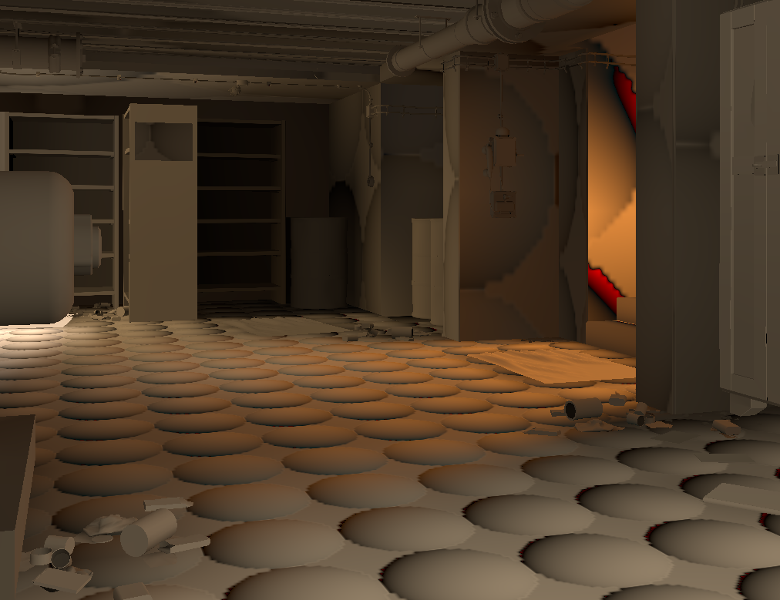
SH2
Notes:
Linear SH without any least squares projection can ring (the red coloring is ringing), and it is a lot flatter than AHD/SH3.

Slide 68
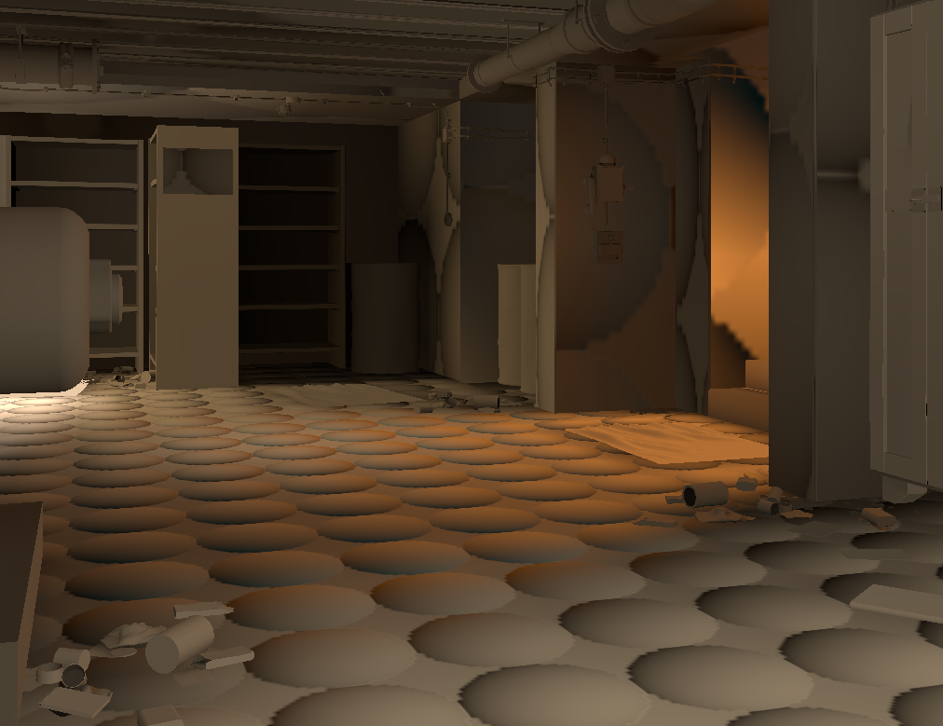
Hbasis (SH2Hemi)
Notes:
The Hbasis is flatter than AHD, it can ring (de-ringed in this example, which looses directional contrast.)

Slide 69
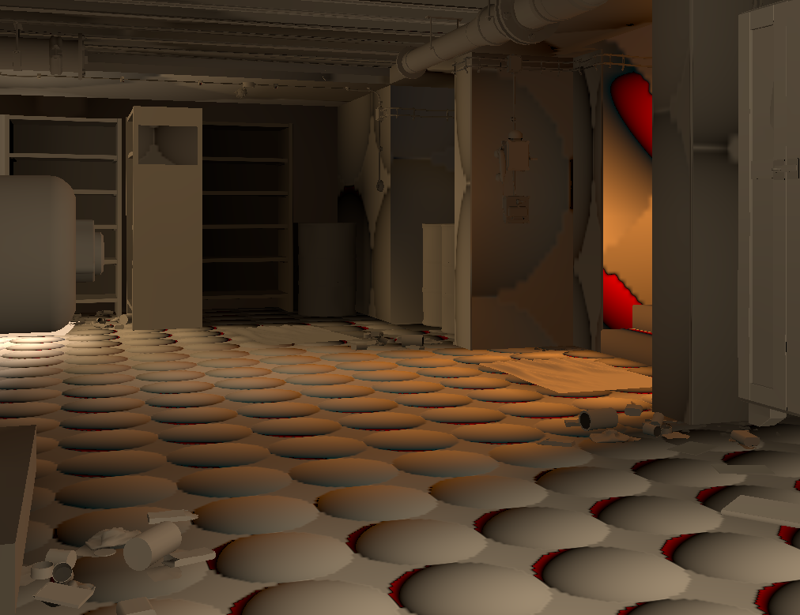
Hbasis (NoWindow)
Notes:
Here is the hbasis without de-ringing, which has more contrast but also can go slightly negative. It might be you can window less aggressively (the windowing algorithm employed only changes the non local Z functions and guarantees that the function is strictly positive.)

Slide 70
Hbasis (SH2Hemi)
Notes:
Here it is with windowing again.

Slide 71
AHD
Notes:
And AHD for comparison.

Slide 72
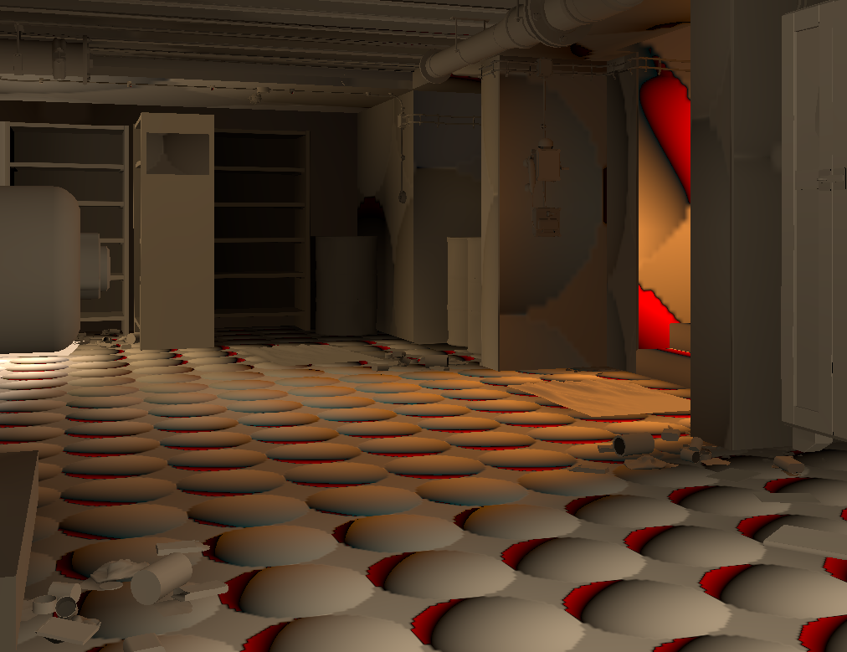
Eigen3
Notes:
Here are the first 3 eigen basis vectors, this is less memory than H-basis (3 basis functions vs. 4), but you would need to implement a de-ringer.

Slide 73

Eigen4
Notes:
First 4 eigen vectors, same memory as h-basis, but better directionality, and also would need a de-ringer.

Slide 74
AHD
Notes:
We ended up going with AHD, while they can have interpolation issues, they are inexpensive, and have high contrast with normal maps. You still have to determine how to projection lighting in them.

Slide 75
PROJECTION FROM SH to AHD
Two options:
Simple least-squares fit - for use in shader
SH optimal linear direction – D
More fancy solve for the bake time
Constrained fit of A/H
Optionally filter hilite direction before solve
Direct lights or large changes in hilite direction cause interpolation artifacts
Notes:
During the bake we generate world space SH data (3rd order for lightmaps, 4th order for models), and project into AHD at two spots. In the vertex shaders when using decoupled visibility (after multiplying with self-vis) and during the bake with additional constraints that I will describe next.
AHD can struggle if the hilite direction changes quickly. This mostly happens with lights that bake direct lighting into the lightmaps. There is an option to filter the optimal linear direction before AHD fitting that helps this, but was only used on a couple of maps.

Slide 76








LEAST SQUARES SH TO AHD
̂
̂
Source as SH (l - light env. convolved with cos):
Target as SH (a – ambient light – just DC, b - dir. light convoleved with cos):
Minimize the squared difference:
Partial derivatives w.r.t. degrees of freedom:
Simplifying, rearranging, using SH orthonormality:
Setting partials to 0:
Solve
Notes:
This is the derivation in the unconstrained case, and is what we use going from vertex to pixel shaders. You can go through the math off-line, it’s just here for completeness.

Slide 77
AHD projection
A_{c} + dot(N,H_{d}) H_{c}
A_{c} ambient color
H_{c} hilite color
H_{d} hilite direction
Luminance optimal linear
A_{c} + H_{d}.z * H_{c} = C_{z}
Scalar irradiance preserved without normal maps
A_{c} and H_{c} non-negative
N
H_{d}
Notes:
AHD stands for Ambient Hilite Direction. It is a simple model – just a directional and ambient light at each texel.
For our lightmaps the solver we used is a bit more sophisticated. If there is no normal map, we want to preserve scalar irradiance – so the fit is invariant to that.
We also want to force the ambient and hilite colors to be non-negative.

Slide 78


AHD projection
Constraint Equation (matrix):
$$\left[\begin{matrix}1 & H_{z}\end{matrix}\right]\left[\begin{matrix}A_{c} \\ H_{c}\end{matrix}\right]=C_{z}$$
Constraint
Hilite
Amb
Notes:
If we look at the space of all ambient/hilite colors, we can build some intuition about how to solve using this constraint equation.
On the left we have ambient hilite space, and the color is the squared error with respect to the constraint. The black vector is the constraint axis.
The equation on the right is the constrain equation. It’s a simplematrix that when multiplied by ambient/hilite colors, determines what outgoing radiance is for local Z.

Slide 79


AHD projection
Constraint Equation (matrix):
Null space of constraint:
$$\left[\begin{matrix}1 & H_{z}\end{matrix}\right]\left[\begin{matrix}A_{c} \\ H_{c}\end{matrix}\right]=C_{z}$$
$$\left[\begin{matrix}−H_{z} & 1\end{matrix}\right]$$
Pseudo Inverse:
Pseudo Inverse Solution
$$\left[\begin{matrix}\frac{1}{1+H_{z}^{2}} \\ \frac{H_{z}}{1+H_{z}^{2}}\end{matrix}\right]$$
Null space
Constraint
Hilite
Amb
Notes:
The white vector is the null-space – given any point in AH space, moving along the null-space of the constraint results in the same radiance when evaluated in the normal direction.
The null space of the constraint is easily computed using SVD, and we can also solve the 1D unnderconstrained problem using the pseudo-inverse (multiply it by Cz.) The red point is this solution, which due to the minimum norm property of the SVD is always the point that satisfies the constraint and is closest to the origin.

Slide 80

AHD projection
Constraint Equation (matrix):
Null space of constraint:
$$\left[\begin{matrix}1 & H_{z}\end{matrix}\right]\left[\begin{matrix}A_{c} \\ H_{c}\end{matrix}\right]=C_{z}$$
$$\left[\begin{matrix}−H_{z} & 1\end{matrix}\right]$$
Pseudo Inverse:
Parameterization of solution:
Pseudo Inverse Solution
$$\left[\begin{matrix}\frac{1}{1+H_{z}^{2}} \\ \frac{H_{z}}{1+H_{z}^{2}}\end{matrix}\right]$$
$$\left[\begin{matrix}\frac{C_{z}}{1+H_{z}^{2}} \\ \frac{C_{z}H_{z}}{1+H_{z}^{2}}\end{matrix}\right]+\left[\begin{matrix}−H_{z} & 1\end{matrix}\right]z$$
Null space
Constraint
Hilite
Amb
Notes:
So there is a 1D parameterization of the points that satisfy the constraint, shown on the right. We want to now solve for a “z” coefficient that minimizes some other error.

Slide 81


AHD projection
Constraint Equation (matrix):
Null space of constraint:
$$\left[\begin{matrix}1 & H_{z}\end{matrix}\right]\left[\begin{matrix}A_{c} \\ H_{c}\end{matrix}\right]=C_{z}$$
$$\left[\begin{matrix}−H_{z} & 1\end{matrix}\right]$$
Pseudo Inverse:
Parameterization of solution:
Pseudo Inverse Solution
$$\left[\begin{matrix}\frac{1}{1+H_{z}^{2}} \\ \frac{H_{z}}{1+H_{z}^{2}}\end{matrix}\right]$$
$$\left[\begin{matrix}\frac{C_{z}}{1+H_{z}^{2}} \\ \frac{C_{z}H_{z}}{1+H_{z}^{2}}\end{matrix}\right]+\left[\begin{matrix}−H_{z} & 1\end{matrix}\right]z$$
Null space
Constraint
Energy Functional (of null space coordinate):
$$E\left(z\right)=\int{{\left(f_{z}\left(s\right)−L\left(s\right)\right)}^{2}∂s}$$
Hilite
Amb
Notes:
In our case, the other error we minimize is squared error integrated over the hemisphere of the lighting environment.
We visualize the error for this example, where blue is low error and red is high error.
This is just minimizing a 1D function, so is straighgtforward. You blow out f_z into SH, differentiate the error function with respect to z (the only DOF left) and solve for zero.

Slide 82

AHD Projection
Mix of 2 directional + ambient
Hilite
Amb
Notes:
This is a plot of the error along the line segment defined by the null space, and you can see we have a nice minimum that is a reasonable point in ambient/hilite space.

Slide 83

AHD Projection tough case
Color channel not aligned with luminance
Negative Hilite color is least squares
Hilite
Amb
Notes:
So why would either color ever be negative? This isn’t that common, but where AHD struggles is when you have strong color bounce. Say you have a bright red-green light to the right, and a dim blue light to the left.
The optimal linear direction will point to the right, which causes the fit for blue to want to have a negative hilite color, ie: the lobe direction we have to use is in the wrong direction.

Slide 84

AHD Projection tough case
Color channel not aligned with luminance
Negative Hilite color is least squares
Hilite
Amb
Notes:
In this case we would end up with the intersection of the white line and Y axis (where hilite color is zero.)
Given a convex optimization problem, with simple non-negativity constraints, the solution will always be the global minimum, or a point on the boundary of the valid region. In our case we have a 1D space, so we only need to test the two boundary points (ambient zero or hilite zero), and the one closest to the unconstrained minimum will always be the best.

Slide 85
Spherical Harmonics Interlude
Notes:
I am going to have a brief digression to talk about ringing in spherical harmonics, and what we did to get around it for this project.
It turns out that having visibility multiplies at run-time makes ringing a larger problem then when just considering irradiance.

Slide 86
Spherical Harmonics
L is band, m is function in band (-L..L)
Notes:
The lower index of a basis function represents the band, the upper index a basis function in a band.

Slide 87
Spherical Harmonics
Band L has (2*L+1) functions
Order N: bands through N-1, N² functions
Notes:
Each band has 2l+1 basis functions and the SH through order N consists of all the bands through N-1 and consists of N^2 functions.

Slide 88
Spherical Harmonics
Notes:
The basis functions can be represented in spherical coordinates (shown here.) This is the most common definition shown in text books/the web, and is extremely useful when doing symbolic computations, but not so useful when writing code/shaders.

Slide 89
Spherical Harmonics
Notes:
In Cartesian coordinates the basis functions are simply polynomials. Shader and CPU evaluation code tends to use this representation.

Slide 90
Zonal Harmonics
Notes:
We’re going to make use of a subset of the spherical harmonics called “zonal harmonics”, shown here in the center column.
Zonal harmonics have only 1 basis function per band, and represent polynomials in Z.
Any function that has circular symmetry around the Z axis when projected into SH only has non-zero coefficients corresponding to the zonal harmonics.

Slide 91
Ringing SH
Notes:
Here is an example of color artifacts that can happen. You have a white ambient light and a bright yellow directional light.
The negative lobes pull out red and green, leaving the blue color artifacts. Windowing can get rid of these artifacts.
You also have the positive lobes (order 3) and negative lobes (order 6).

Slide 92
Windowing
See stupid SH tricks [Sloan08] for various approaches
Attenuates high frequencies
Can pose as a regularized least squares projection
Any global value will fix some probes, but hurt others
Lighting signals should be strictly positive when converted to irradiance
Apply the same filter to all color channels
Compute for each independently, take the most aggressive one
Approach – find window that makes smallest point positive
Notes:
There are a bunch of ways to combat ringing, the most straightforward ones are to window the high frequency coefficients. If this is just done globally though, it will over smooth lighting environments that actually aren’t having any problems. So we want to window as little as possible to get eliminate the artifacts, in our case make sure that when convolved with a normalized cosine, the function is strictly positive.
One not on windowing is we want to apply a window that is the same for all 3 color channels, so that we don’t get any funky coloring artifacts. To do this we compute the window on the color channels independently, and simply take the most conservative one.
For our solution, we want to quickly find the smallest value of the SH on the sphere, and use that routine inside a search over windowing values to guarantee a non-negative result.
In general this is minimizing a quadratic function over the sphere, and there will be lots of local minima, so instead we wanted a simple conservative bound.

Slide 93

Results Old
Notes:
Here we show an earlier algorithm, that overly blurs the lighting.

Slide 94

Results New
Notes:
While the new one is strictly positive and has more angular detail.

Slide 95
Insights
The linear band is *always* a ZH, so rotate to that frame (“optimal linear”)
Zeros out two basis functions, SH is the same
Decompose to ZH + orthogonal complement
ZH “most negative” is analytic
Minima of ZH (after convolution) is trivial to locate – quadratic polynomial in Z
Minima is one of {-1,1,-b/(2a)} (last only if a>0)
Binary search over window until strictly positive
Notes:
All linear functions have a coordinate system where the SH are just a ZH. The gradient of a linear function in R3 has a direction, and if we make that Z, it will zero out the x/y SH basis functions, going from 2 to 3.
ZH have circular symmetry, which means they are a function of just Z, so to find the minimum you have a univariate polynomial, which is easy to solve. Given the coefficients of the quadratic polynomial (ax^2 + bx + c), the minimum is –b/(2a) only if a > 0 (otherwise that’s a maximum) *or* one of the boundary points (z = +/- 1).
We can simply do a binary search over windowing parameters, but still need to account for the non ZH part (4 coefficients in this case.)

Slide 96
What about non-ZH?
+M / -M are rotated copies
Any combination is rotated
Conservative bound, f(Z)
M=-2
M=-1
M=1
M=2
Notes:
So we have 4 basis functions left, and there is a special property of those that we can exploit as well.
If |M| is a non-zero constant, the basis functions are simply rotations in Z of each other (the angle I believe is 90/L). This means that if we can reason about the shape of these functions, there is always a phi that has the worst case. So we simply need to turn that into a function of Z.

Slide 97




What about non-ZH
They simply rotate around Z (obvious from Z rotation matrices)
For what phase (phi) is Y(theta,phi) largest as a function of Z?
Minimum will always occur along that cross section, turn it into f(Z)
|m|=2
|m|=1
Notes:
This property is illustrated for |m| = 1 and |m| = 2 here, where any blend is clearly a rotation of one shape.

Slide 98

How to lump M’s
Any coefficient pair is a rotated function
Find worst case and make them line up
Preserve the norm of the pair
Reparametrize as a function of Z
|M|=2
x^2+y^2+z^2 = 1 (on sphere)
xy when x==y=>2x²+z²=1=>x²=(1-z²)/2
Just modify quadratic! This one is easy
|M|=1
xz when y is 0=> x² +z²=1 => x=sqrt(1-z²)
Ugh, tried to bound but not great
Just use Newtons method instead
Notes:
So given the two basis functions for a band, say |m| = 2, we simply use a coefficient sqrt(b0^2 + b1^2), and can analyze the worst case for that.
When |m| = 2, the worst case happens when x==y, so you simply replace the variable, and then make it a function of Z, and you get the blue curve above (1-z^2), you take the negative lumped energy and can minimize this with the ZH function.
When |m| = 1, it is a non polynomial. So for this, we simply use newtons method with a good starting point, and we quickly get the minimum. We use a positive sign, since this function is negative in the lower hemisphere (opposite the optimal linear direction), which is where the most negative point tends to be.

Slide 99

Leveraging detecting the most negative value
No windowing is one extreme
Delta function is “peakiest” signal
Window so is strictly positive
Slight boost of linear to do this
Search to find window that results in non-negative projection
Notes:
So now that we have determined how to quickly determine if a SH has a negative, we need to come up with a family of windows. There are two extremes:
No windowing, which is simply a delta function.
A window function that forces any lighting environment to be strictly positive. For this we take a delta function (the peakiest function in SH), and window it so the tail (visualized in the graph above – from Pi/2 to Pi) is strictly positive. This is a windowed lancosz filter + a small attenuation of the linear SH to make the tail stay positive.
The intermediate points are just other less aggressive window functions from the same family.

Slide 100
What could be improved?
This only deals with negative lobes, can be large positive lobe
Do extra convolution, hand tuned, after evaluating point lights – small amount
Assumes perfect correlation between |m| == 1 and |m| == 2 bands
Can we down-weight one of them?
Higher order just comes along (issue for products?)
Notes:
So this only deals with the negative lobes, there can be rings from positive lobes as well (like the anit-podal location from a point light source), we do a small amount of extra windowing for direct lights before their radiance is added to SH to minimize this.
The only remaining approximation is that the |m| = 1 and |m| = 2 are perfectly in phase, so have maximal destructive interference. It is unclear if addressing this really helps, since the lower bound can still have slight positive rings, but it might be possible to down weight them based on the relative phase that exists.
Finally, this is focused on quadratic SH, for higher orders we simply use the same windowing coefficients just evaluated at higher bands, but minimize using quadratic only. We use cubics internally as well sometimes.

Slide 101
Results Old
Notes:
Here is a comparison again, old technique crushes directionality a bit too much.

Slide 102
Results New
Notes:
New technique maintains it.

Slide 103

Results Old
Notes:
Here we see an area where the old technique over penalizes some lights, and makes other (black ring on the middle right) actually negative.

Slide 104

Results New
Notes:
The new algorithm preserved directionality better, and is strictly positive.

Slide 105
Baking for decoupled lighting
Can bake
But where?
All across the object!
Notes:
Now we are going to talk about how we bake for static models with decoupled lighting.
We do this by sampling over the surface of the model, and then solving for lighting coefficients that when interpolated, multiplied by self-vis and evaluated at the sample locations mimize squared error.

Slide 106

Static geo sample selection
Per Model
Generate multiple stratified sample sets in object space, based on number of probes, importance sample based on self-visibility
Per Instance
draw from samples, until you have enough “valid” ones
Back face hits, particularly of structural/lightmapped objects
Caulk can be placed under ground to validate
Geometric and arithmetic mean distances (don’t want buried samples)
Store bitmask for rays that don’t self-intersect (for baking)
Notes:
We have two phases. First for every model we generate lists of sample candidates in object space. These are done by importance sampling by self-vis over the model (areas that are very occluded are not visible to the player, so have less weight.)
The second phase is per-instance, where we shoot a bunch of “feeler” rays out, to determine if a sample is buried, underground, etc. Lights can optionally place brushed in regions that should never be visible to help invalidate samples, though that’s only occasionally done in practice.
Here the red points are valid, and the blue are invalid.

Slide 107

Static geo sample selection
Per Model
Generate multiple stratified sample sets in object space, based on number of probes, importance sample based on self-visibility
Per Instance
draw from samples, until you have enough “valid” ones
Back face hits, particularly of structural/lightmapped objects
Caulk can be placed under ground to validate
Geometric and arithmetic mean distances (don’t want buried samples)
Store bitmask for rays that don’t self-intersect (for baking)
Notes:
When we draw more of the models near this truck, you can see that the points were invalidated because they were underneath the container things on the truck. If we included them, the lighting would be much darker and not match the surrounding areas as well.

Slide 108
StatIC GEO Solve
Least squaes solve for the probes so that *reconstructed* lighting – after multiplying with visibility and convolved with a cosine – matches the baked one 9 DOF per sample location
Visibility product results in mixing of DOF, so can’t solve independently
Angular regularization is important
Non-negative DC component, ratio of linear to DC energy must be within bounds of directional lights (so things don’t go crazy)
Exponential search for regularizer based on squared Laplacian
Notes:
For the solve, we want to know what coefficients for the lighting, when interpolated to each sample and multiplied by self-vis, would describe the lighting data gathered at that sample.
Each point is then a 9x9 block matrix, where we multiply by self-vis (and convert to irradiance.)
Adding regularization to this solve is important, if you only have points on a plane, the “bottom hemisphere” could have any lighting values, but we don’t want it to do anything crazy, since a titled normal could sample it, etc.
We use exponential search and a simple oracle to find the minimum amount of angular regularization (squared Laplacian over the sphere penalty term) that makes the lighting reasonable. Where reasonable has two criteria: 1) DC must be non-negative (negative DC can’t happen from real light intensities) 2) the ratio of linear to DC energy must be less than a delta function ( the peakiest light possible with SH).

Slide 109
BAKING LIGHT GRID
We could just bake lighting at the vertices of the tet mesh, but the lighting there is not really what we want
We want the final lighting, interpolated taking visibility into account to be correct, everywhere on the level
Least sqaures again
Compute lighting in a number of points in each tet
Compute interpolation weight for those points as they are computed during reconstruction, taking visibility into account
Solve for lighting at the vertices of the tet mesh that generates that signal as closely as possible
Also add Lapalacian regularizer (fancy term for penalizing rapid changes between neighboring probes – this also takes visibility into account – if probes don’t see each other we don’t really care)
All this acts as a form of denoising/antialiasing – we can reduce the quality of lighting computations on individual samples
Notes:
Similarly for the light grid, we super-sample the tets spatially, and solve for the lighting at the vertices that when interpolated explains the lighting at these sub-samples, but only the vertices that are directly visible.
We also add a spatial regularizer with a fixed weight – we want to make sure that the resulting lighting is smooth and doesn’t have a lot of oscilations.

Slide 110
CONCLUSIONS
Think of different components of the rendering equation separately
With more detailed lighting the representations become more complex – resample to simpler structures to mitigate the cost
Least squares is your friend, but don’t forget to regularize
Notes:
To conclude, splitting the rendering equation into different parts (as others have done) is generally a good idea. Splitting visibility from incident radiance helped improve quality significantly in our case.
Having different representations – heavy weight ones that are sparsely evaluated, combined with light weights ones that are densely evaluated, can be a good thing.
We use least squares a lot, but you almost always need to combine it with some form of regularization.

Slide 111
References
[Annen04] Annen, T, Kautz, J, Durand, T, Seidel, H-P, Spherical Harmonic Gradients for Mid-Range Illumination, EGSR 2004
[Chen08] Chen, H, “Lighting and Materials of Halo3”, GDC 2008
[Cupisz12] Cupisz, R, “Light Probe Interpolation using Tetrahedral Tesselations”, GDC 2012
[Engelhardt08] Engelhardt, T, Daschbacher, C, “Octahedral Environment Maps”, VMV 2008
[McT04] McTaggart G, Half-life 2 source shading, GDC 2004
[Lazarov13] Lazarov, D, “Getting More Physical in Call of Duty: Black Ops II”, SIGGRAPH PBR Course 2013
[Iwanicki13] Iwanicki, M, Lighting Technology of “The Last of Us”, SIGGRAPH Talk 2013
[Iwanicki17] Iwanicki, M, Sloan, P-P, Ambient Dice, EGSR 2017, EI&I
[Schaefer04] Schaefer, S, Hackenberg, J, Warren, J, “Smooth Subdivision of Tetrahedral Meshes”, SGP 2004
[Sloan08] Sloan, P-P, “Stupid Spherical Harmonics Tricks”, GDC 2008

Slide 112
Acknowledgements
Central Tech
Adrien Dubouchet
Manny Ko
Dimitar Lazarov
Josiah Manson
Mike Stark
Infinity Ward
Michał Drobot
Olin Georgescu
Ifedayo Isibor
Kyle McKisic
Peter Pon
High Moon Studios
Martin Ecker
Stephane Etienne
Sledgehammer Games
Dave Blizard
Danny Chan
Stephanus
Luka Romel
Atsushi Seo
Notes:
Before i start i wanted to say that *a lot* of people contributed to the ideas we will present here and we wanted to thank them all for that

